Slide 1


Public Health
Intelligence Library
2026

Slide 2
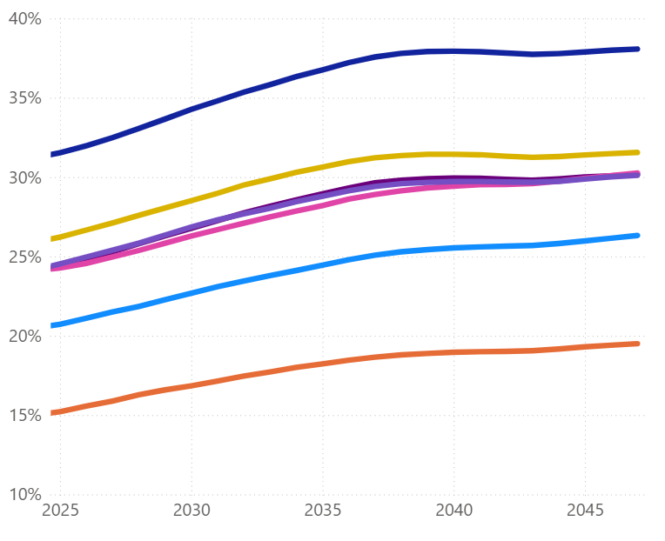
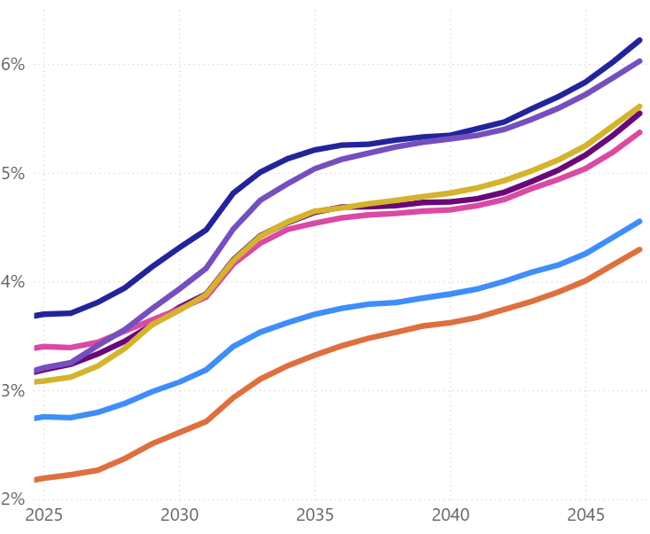
  Ageing population
By 2047, over 30% of people living in Lincolnshire will be aged 65+ and 5.5% will be aged 85+, compared to 23% aged 65+ and 4.2% aged 85+ in England.
Projected percent of population 65+ years old
Projected percent of population 85+ years old
East Lindsey
East Lindsey
South Kesteven
West Lindsey
North Kesteven
West Lindsey
South Holland
South Holland
North Kesteven
South Kesteven
Boston
Boston
Lincoln
Lincoln
Source: ONS Population Projections by Local Authority.

Slide 3
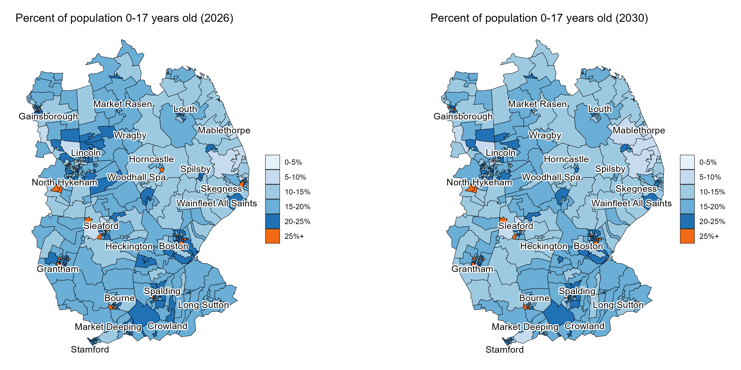
  Ageing population
By 2030, Lincolnshire will be home to around 6.6k fewer people aged 0-17 years old – a decrease of 5% from 2026.
Source: ONS Lower layer Super Output Area population estimates, mid-2024. ONS Population Projections by Local Authority.
Note: Assumes the local authority level age-specific growth rate applies to each constituent LSOA.

Slide 4
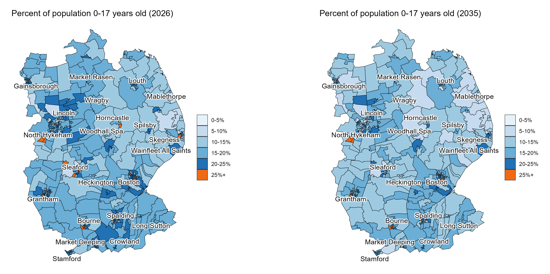
  Ageing population
By 2035, Lincolnshire will be home to around 14.6k fewer people aged 0-17 years old – a decrease of 10% from 2026.
Source: ONS Lower layer Super Output Area population estimates, mid-2024. ONS Population Projections by Local Authority.
Note: Assumes the local authority level age-specific growth rate applies to each constituent LSOA.

Slide 5
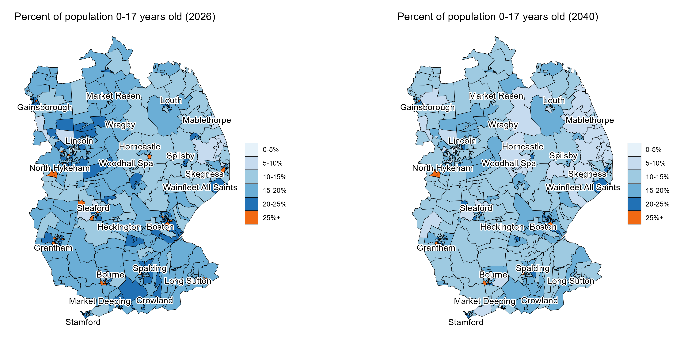
  Ageing population
By 2040, Lincolnshire will be home to around 19.4k fewer people aged 0-17 years old – a decrease of 13% from 2026.
Source: ONS Lower layer Super Output Area population estimates, mid-2024. ONS Population Projections by Local Authority.
Note: Assumes the local authority level age-specific growth rate applies to each constituent LSOA.

Slide 6
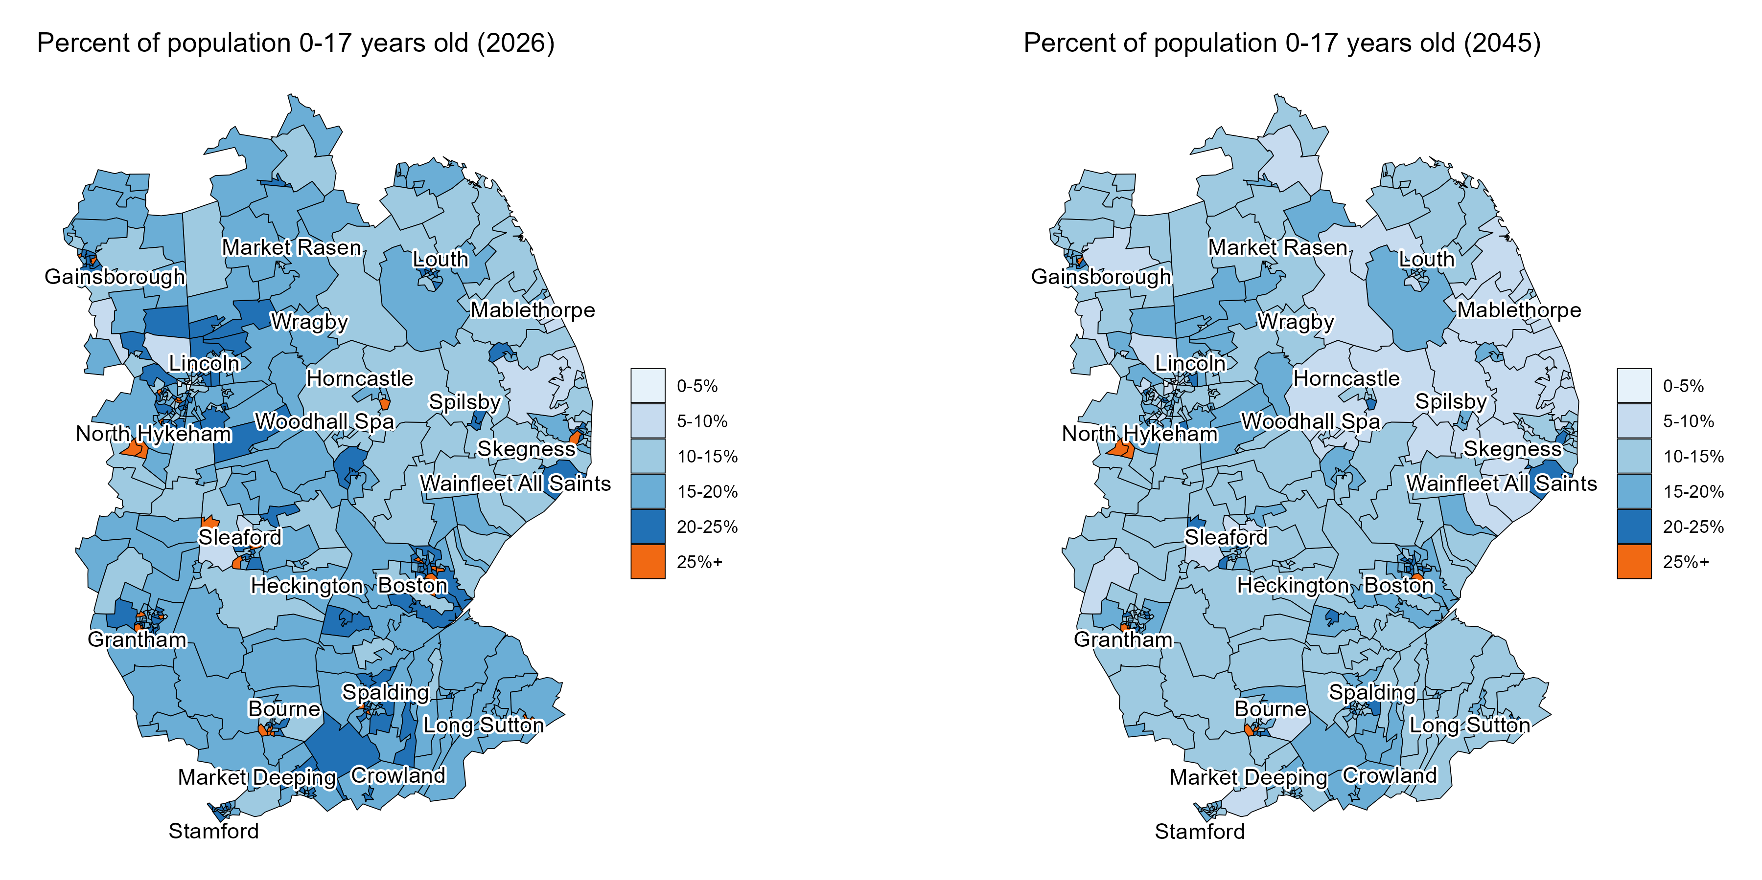
  Ageing population
By 2045, Lincolnshire will be home to around 20.2k fewer people aged 0-17 years old – a decrease of 14% from 2026.
Source: ONS Lower layer Super Output Area population estimates, mid-2024. ONS Population Projections by Local Authority.
Note: Assumes the local authority level age-specific growth rate applies to each constituent LSOA.

Slide 7

  Ageing population
By 2047, Lincolnshire will be home to around 20.2k fewer people aged 0-17 years old – a decrease of 14% from 2026.
Source: ONS Lower layer Super Output Area population estimates, mid-2024. ONS Population Projections by Local Authority.
Note: Assumes the local authority level age-specific growth rate applies to each constituent LSOA.

Slide 8
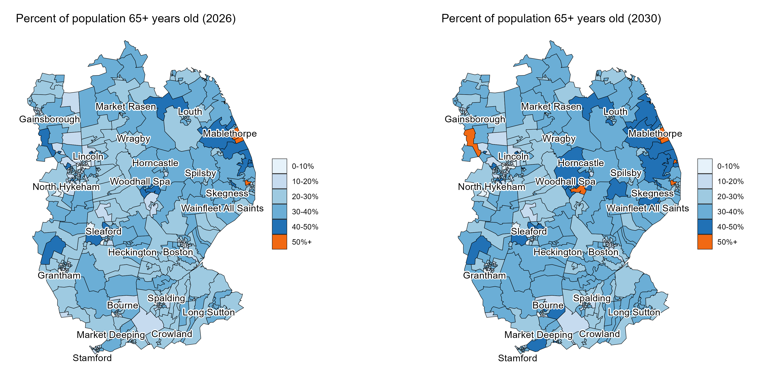
  Ageing population
By 2030, Lincolnshire will be home to an additional 19k people aged 65+ years old
– an increase of 10% from 2026.
Source: ONS Lower layer Super Output Area population estimates, mid-2024. ONS Population Projections by Local Authority.
Note: Assumes the local authority level age-specific growth rate applies to each constituent LSOA.

Slide 9
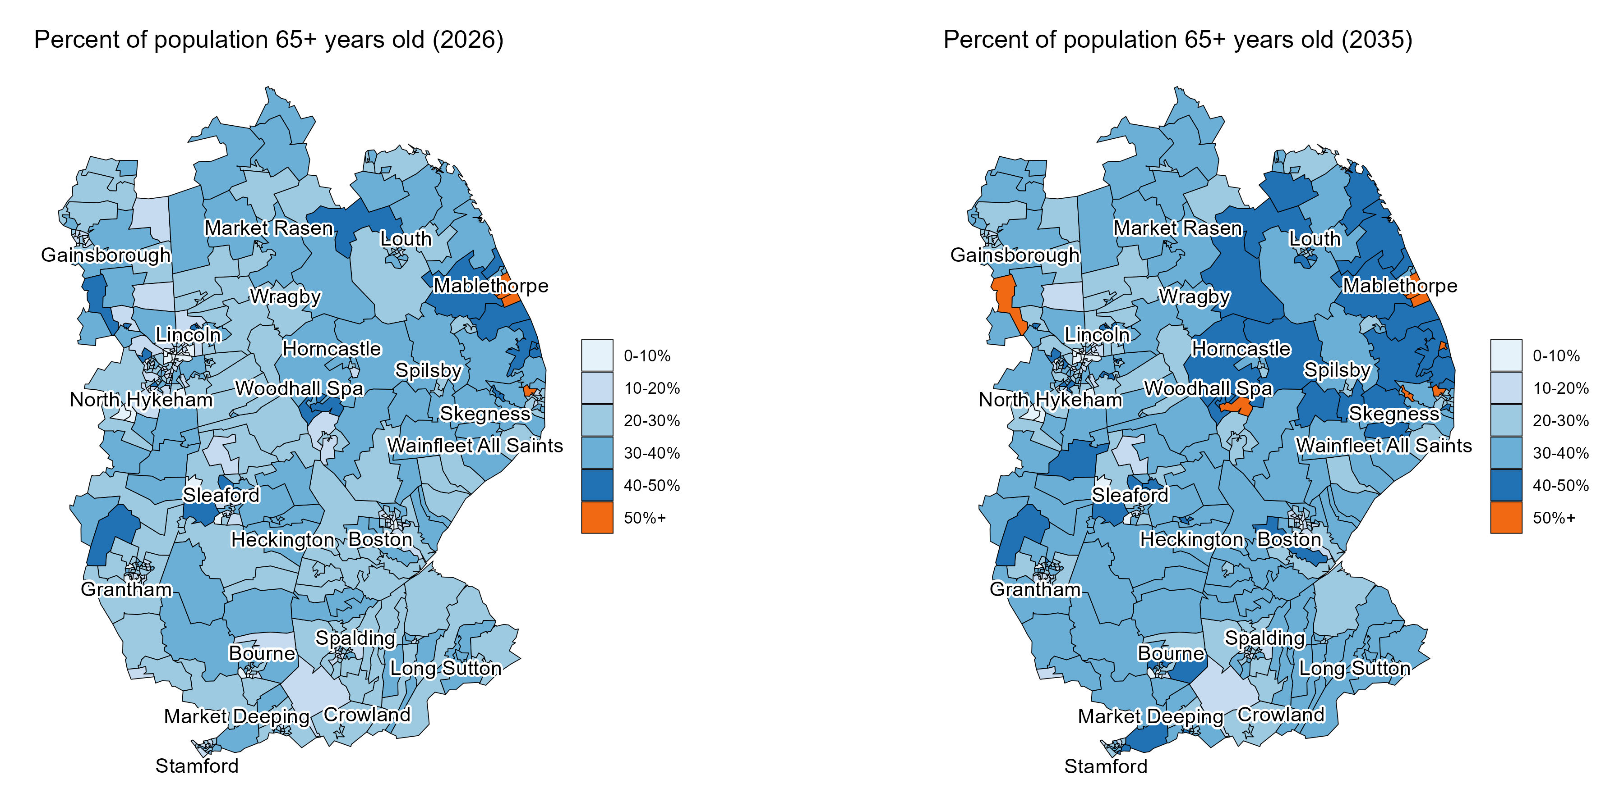
  Ageing population
By 2035, Lincolnshire will be home to an additional 40.4k people aged 65+ years old – an increase of 20% from 2026.
Source: ONS Lower layer Super Output Area population estimates, mid-2024. ONS Population Projections by Local Authority.
Note: Assumes the local authority level age-specific growth rate applies to each constituent LSOA.

Slide 10
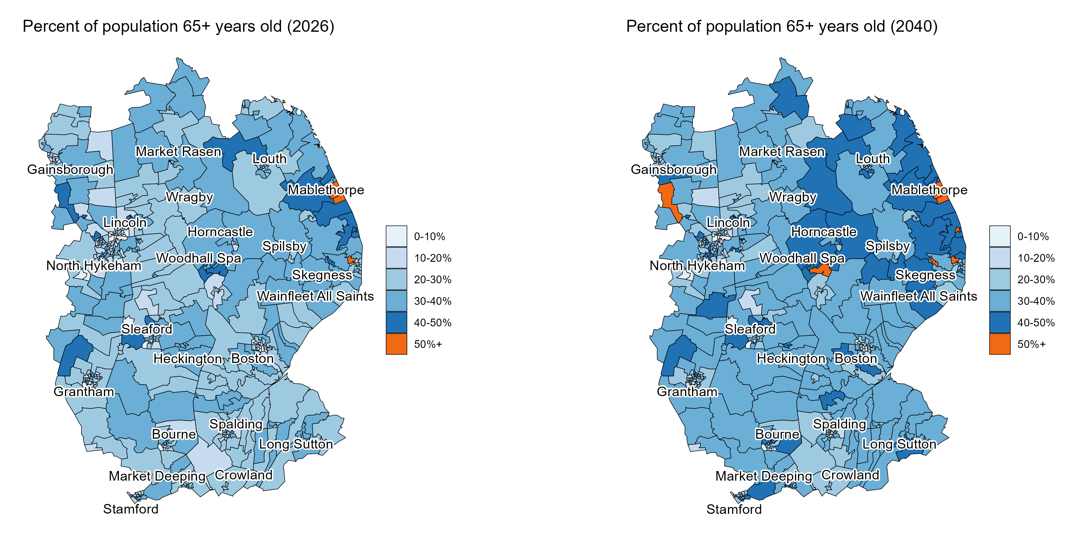
  Ageing population
By 2040, Lincolnshire will be home to an additional 53.4k people aged 65+ years old – an increase of 27% from 2026.
Source: ONS Lower layer Super Output Area population estimates, mid-2024. ONS Population Projections by Local Authority.
Note: Assumes the local authority level age-specific growth rate applies to each constituent LSOA.

Slide 11
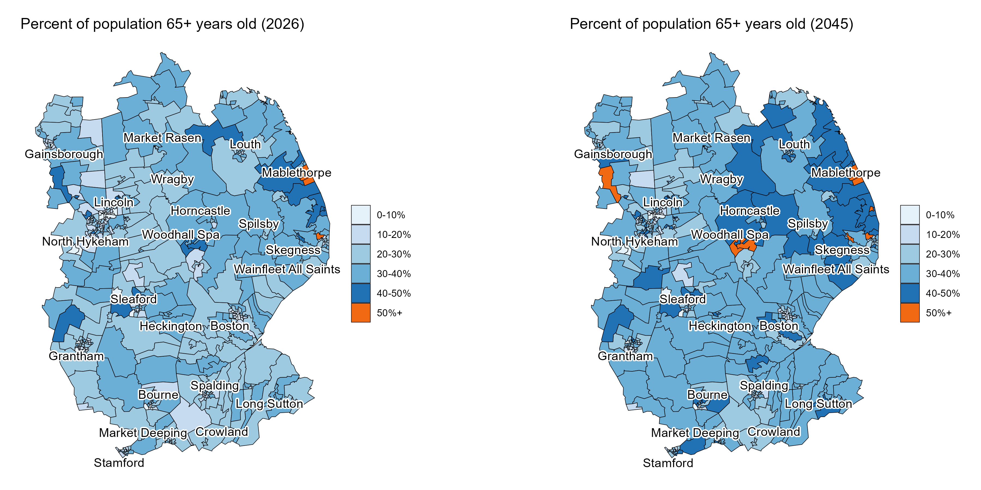
  Ageing population
By 2045, Lincolnshire will be home to an additional 59.5k people aged 65+ years old – an increase of 30% from 2026.
Source: ONS Lower layer Super Output Area population estimates, mid-2024. ONS Population Projections by Local Authority.
Note: Assumes the local authority level age-specific growth rate applies to each constituent LSOA.

Slide 12

  Ageing population
By 2047, Lincolnshire will be home to an additional 63.2k people aged 65+ years old – an increase of 32% from 2026.
Source: ONS Lower layer Super Output Area population estimates, mid-2024. ONS Population Projections by Local Authority.
Note: Assumes the local authority level age-specific growth rate applies to each constituent LSOA.

Slide 13
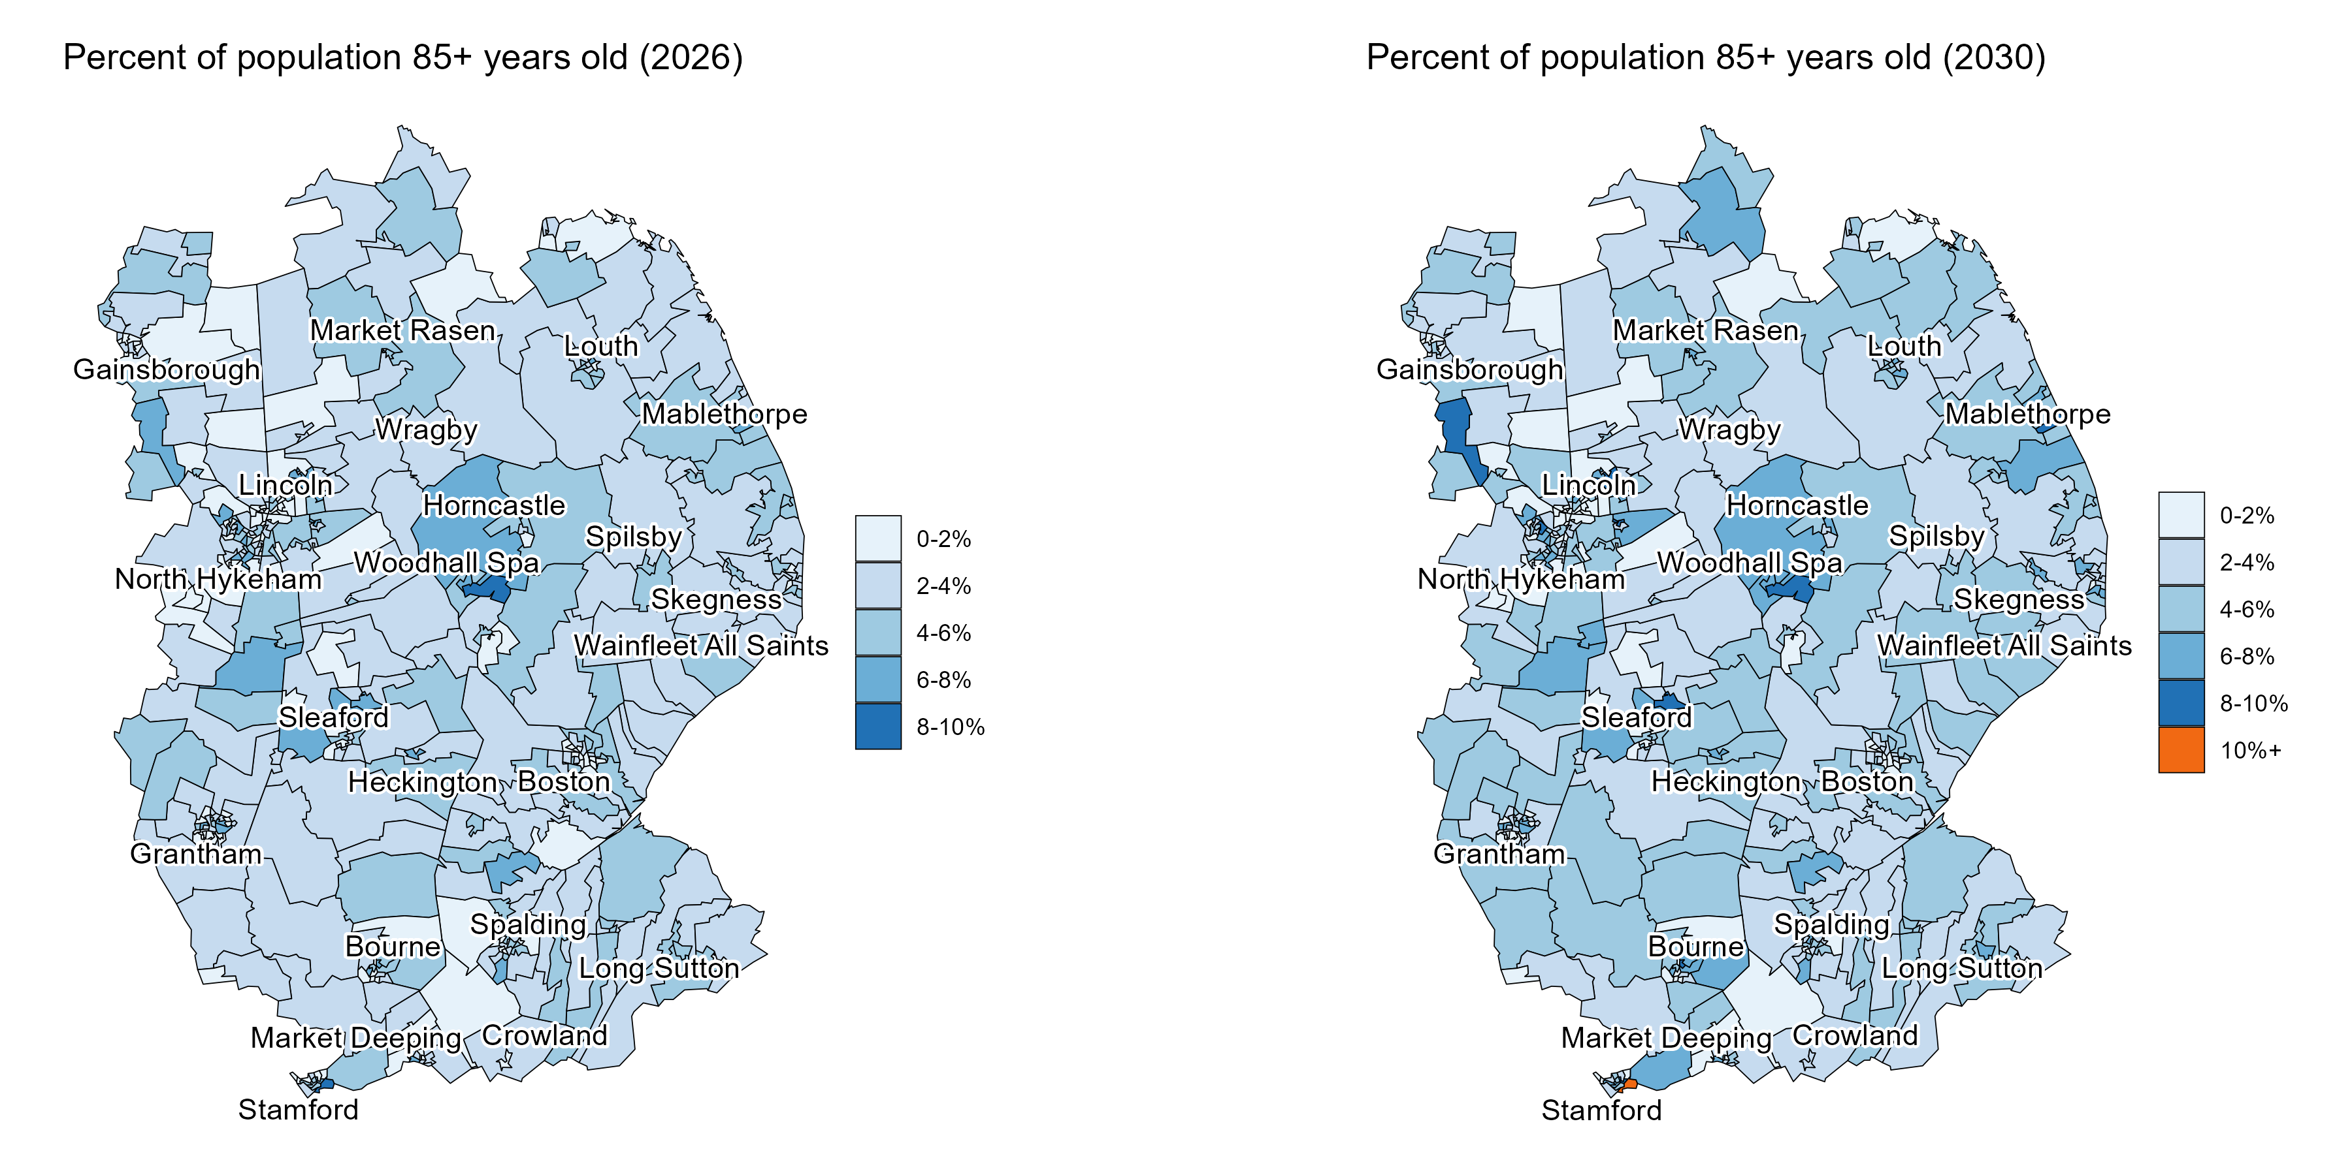
  Ageing population
By 2030, Lincolnshire will be home to an additional 4.7k people aged 85+ years old
– an increase of 19% from 2026.
Source: ONS Lower layer Super Output Area population estimates, mid-2024. ONS Population Projections by Local Authority.
Note: Assumes the local authority level age-specific growth rate applies to each constituent LSOA.

Slide 14
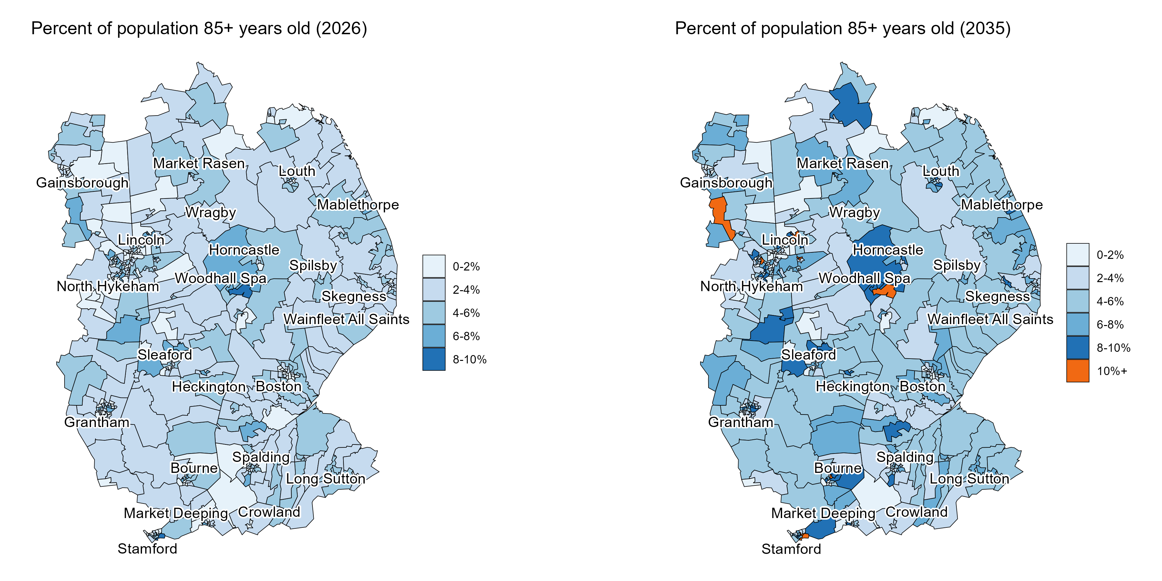
  Ageing population
By 2035, Lincolnshire will be home to an additional 12.6k people aged 85+ years old – an increase of 50% from 2026.
Source: ONS Lower layer Super Output Area population estimates, mid-2024. ONS Population Projections by Local Authority.
Note: Assumes the local authority level age-specific growth rate applies to each constituent LSOA.

Slide 15
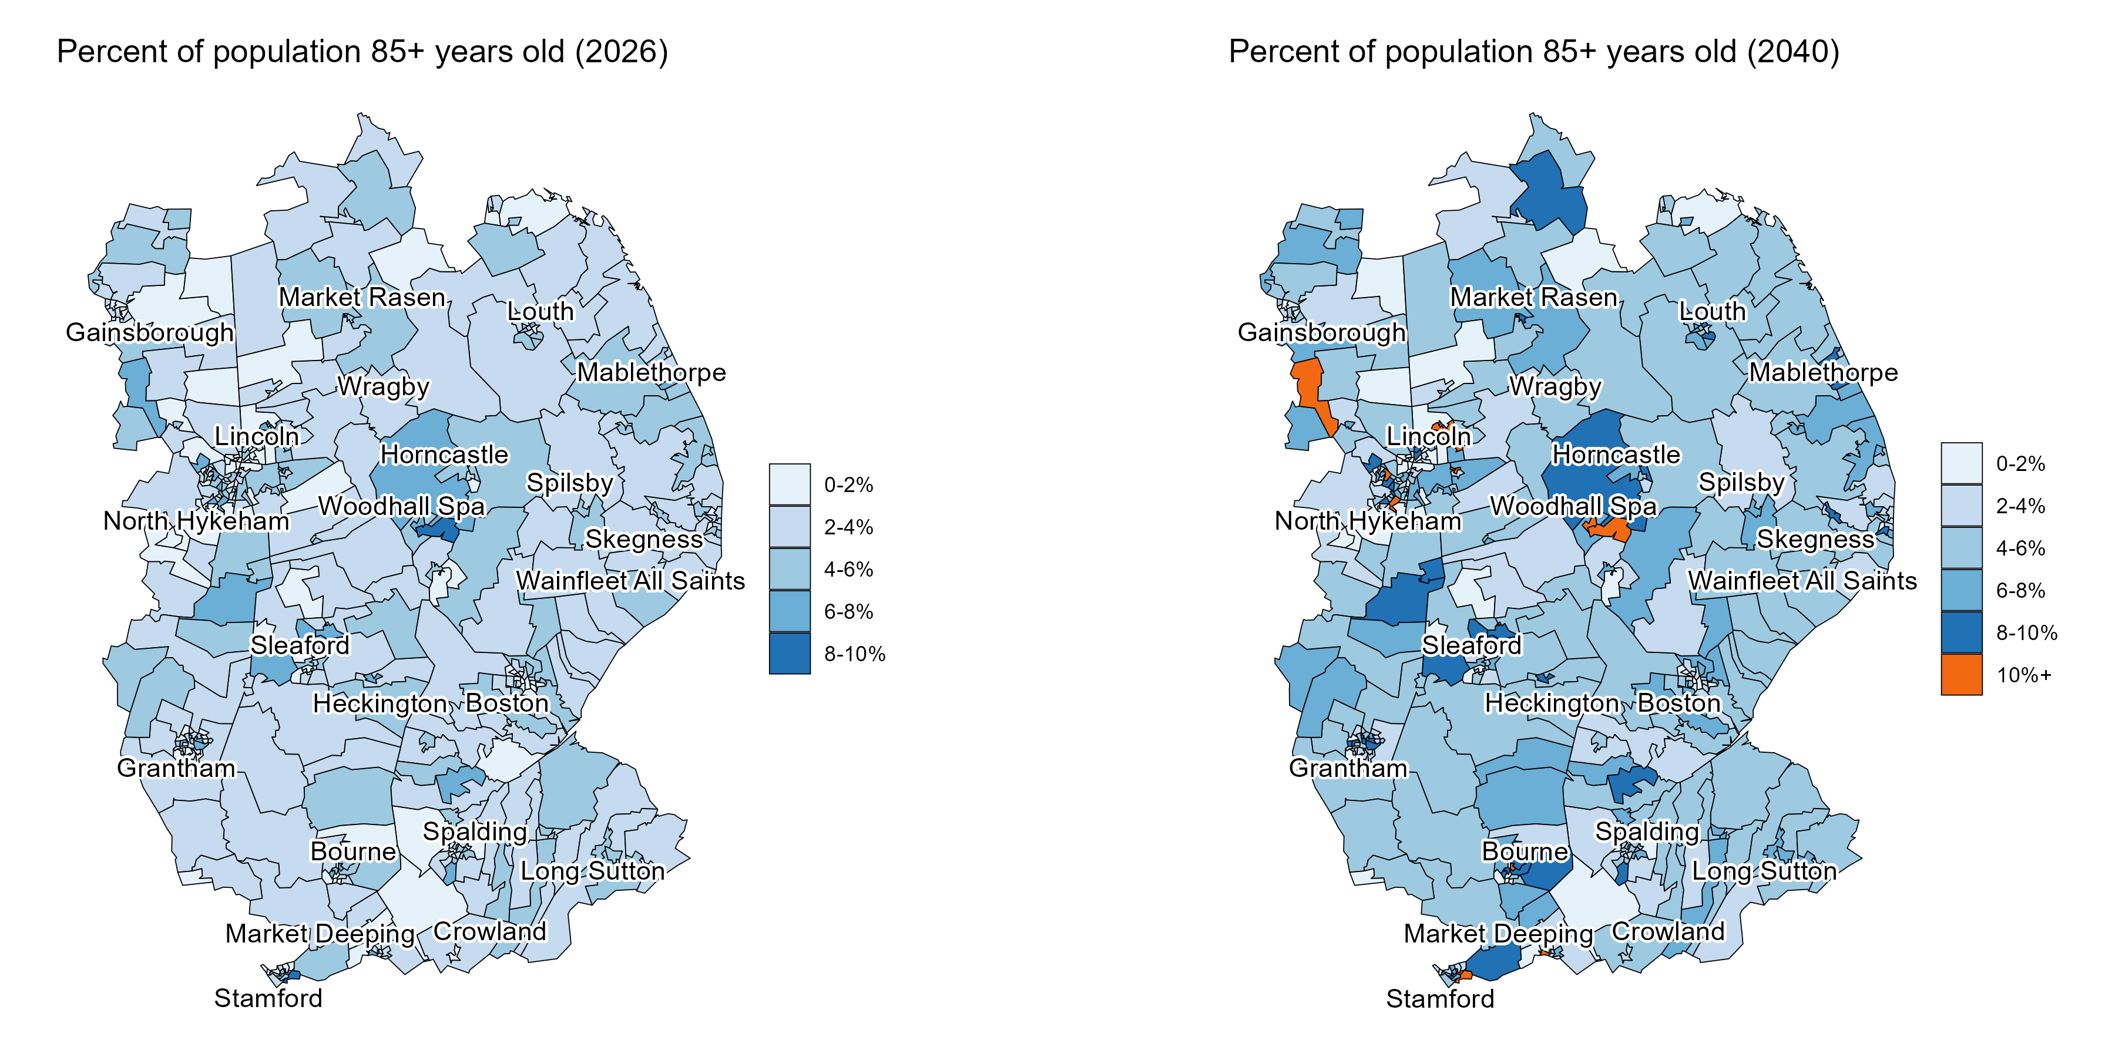
  Ageing population
By 2040, Lincolnshire will be home to an additional 14.9k people aged 85+ years old – an increase of 59% from 2026.
Source: ONS Lower layer Super Output Area population estimates, mid-2024. ONS Population Projections by Local Authority.
Note: Assumes the local authority level age-specific growth rate applies to each constituent LSOA.

Slide 16
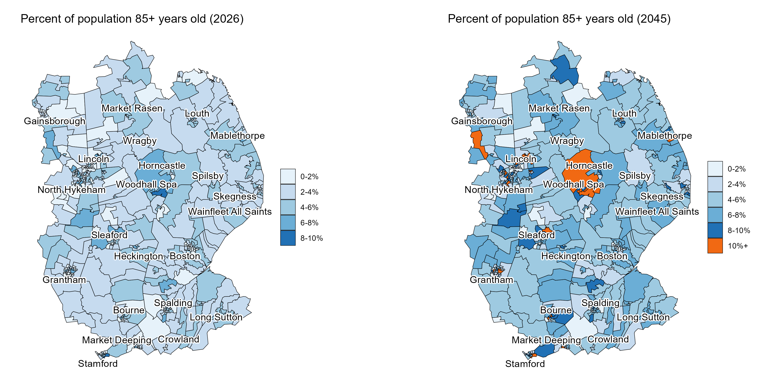
  Ageing population
By 2045, Lincolnshire will be home to an additional 19.2k people aged 85+ years old – an increase of 76% from 2026.
Source: ONS Lower layer Super Output Area population estimates, mid-2024. ONS Population Projections by Local Authority.
Note: Assumes the local authority level age-specific growth rate applies to each constituent LSOA.

Slide 17
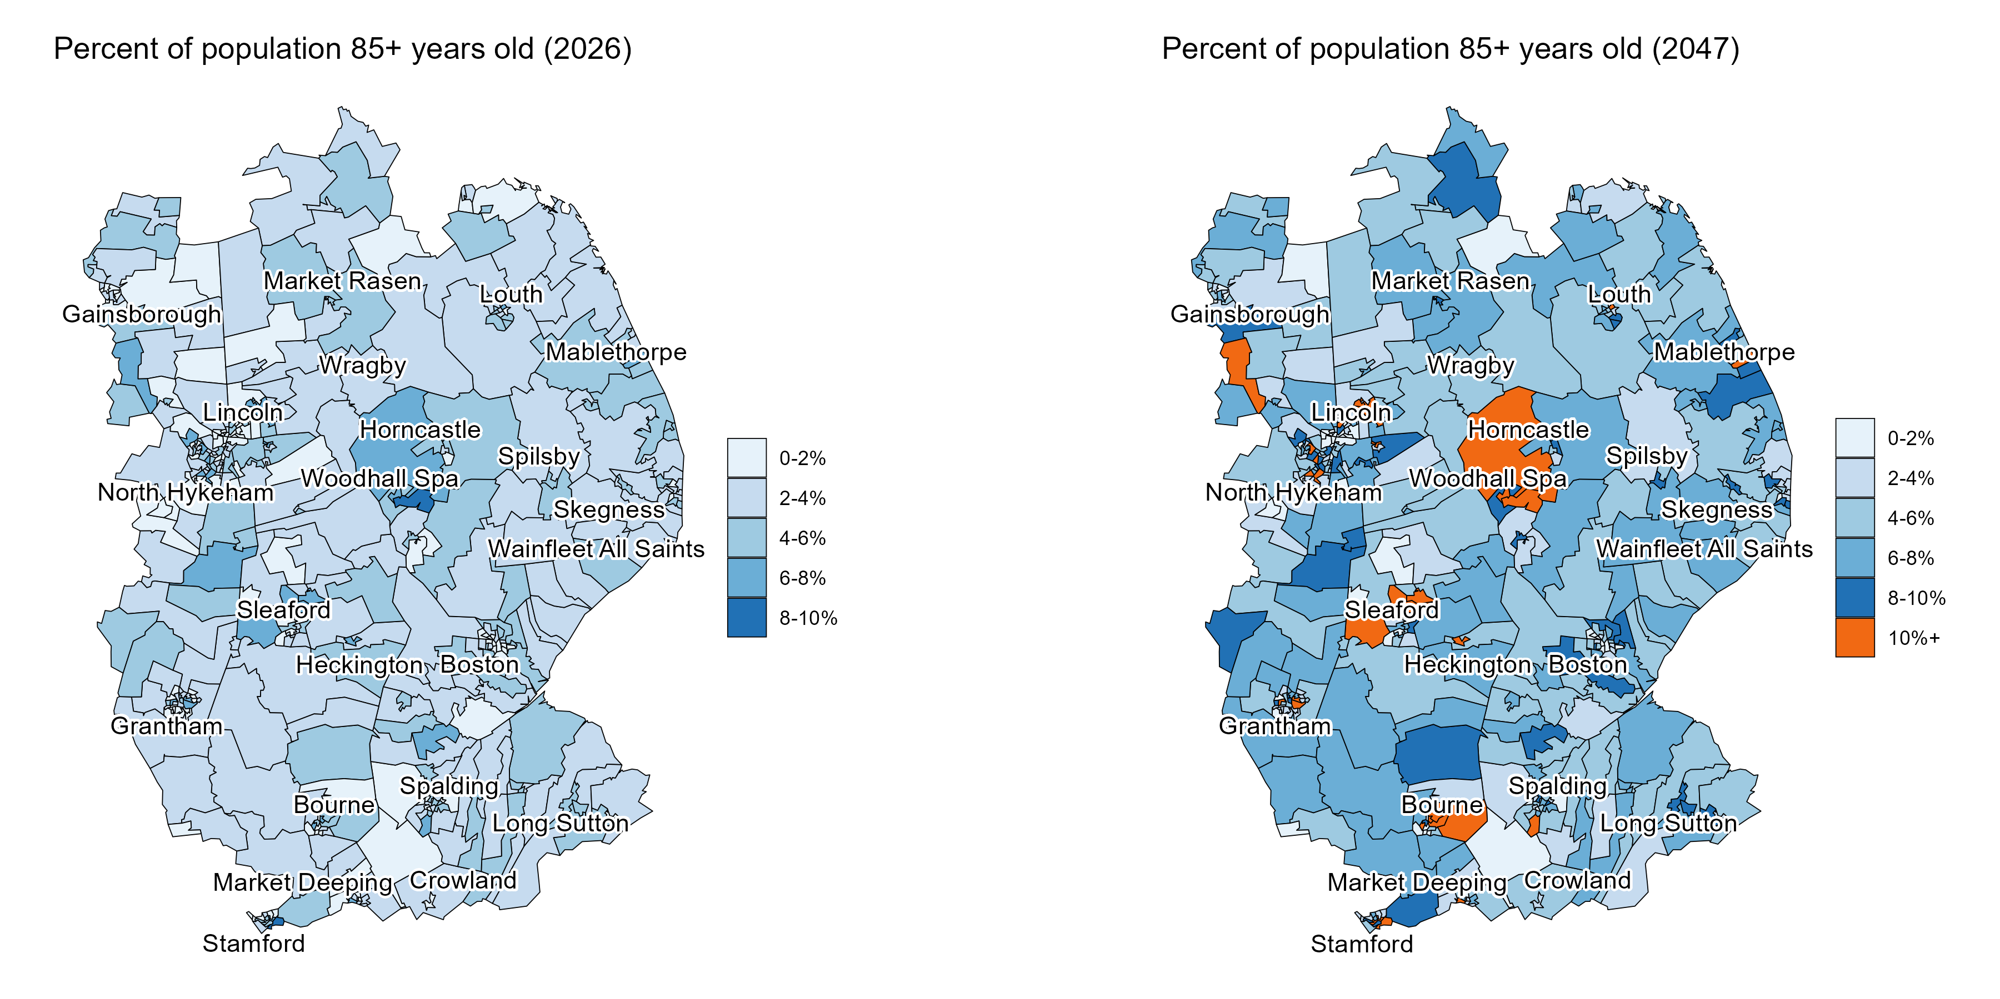
  Ageing population
By 2047, Lincolnshire will be home to an additional 22.4k people aged 85+ years old – an increase of 89% from 2026.
Source: ONS Lower layer Super Output Area population estimates, mid-2024. ONS Population Projections by Local Authority.
Note: Assumes the local authority level age-specific growth rate applies to each constituent LSOA.

Slide 18
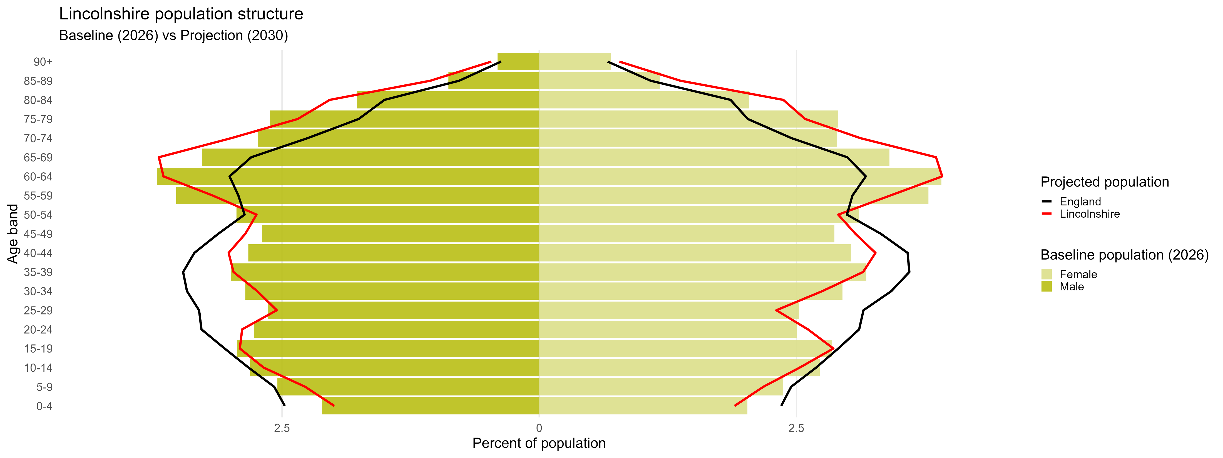
  Ageing population
Lincolnshire’s population structure is expected to become more top-heavy, with a higher proportion of older people and lower proportion of young people
Source: ONS Population Projections by Local Authority.

Slide 19
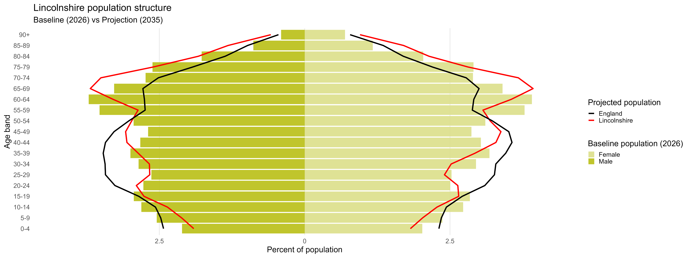
  Ageing population
Lincolnshire’s population structure is expected to become more top-heavy, with a higher proportion of older people and lower proportion of young people
Source: ONS Population Projections by Local Authority.

Slide 20
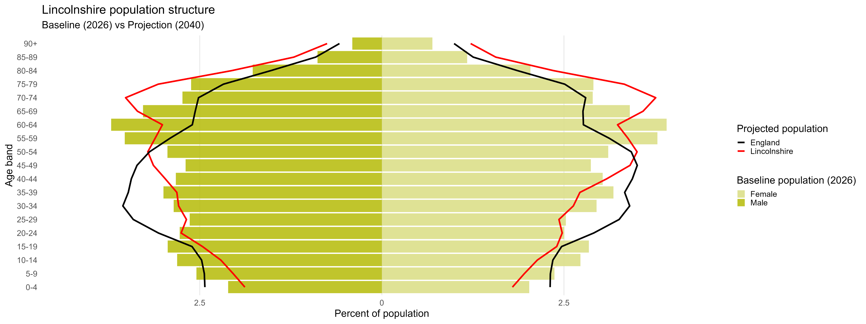
  Ageing population
Lincolnshire’s population structure is expected to become more top-heavy, with a higher proportion of older people and lower proportion of young people
Source: ONS Population Projections by Local Authority.

Slide 21

  Ageing population
Lincolnshire’s population structure is expected to become more top-heavy, with a higher proportion of older people and lower proportion of young people
Source: ONS Population Projections by Local Authority.

Slide 22
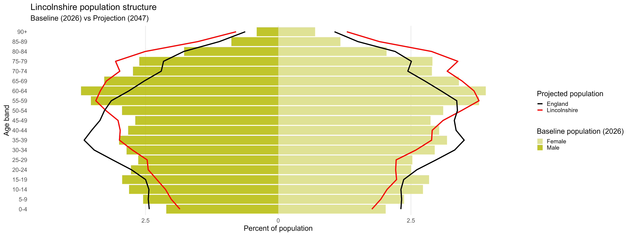
  Ageing population
Lincolnshire’s population structure is expected to become more top-heavy, with a higher proportion of older people and lower proportion of young people
Source: ONS Population Projections by Local Authority.

Slide 23
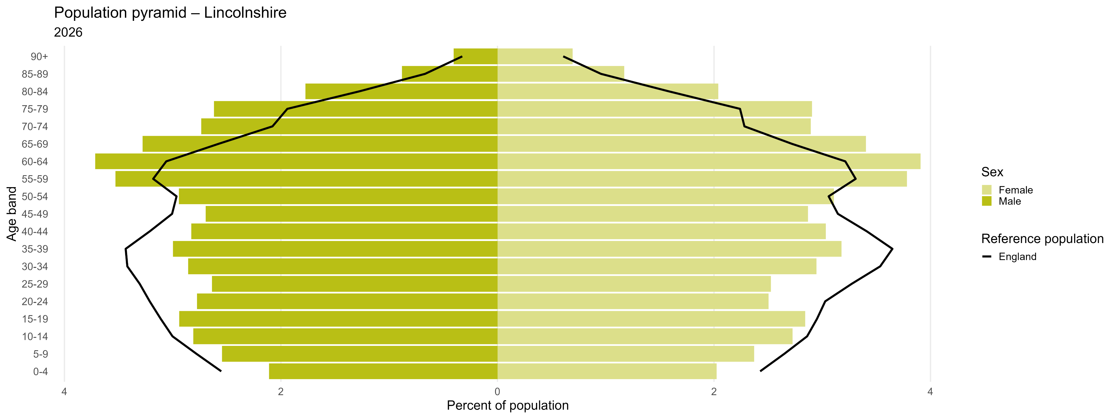
  Ageing population
Lincolnshire’s population structure consists of a higher proportion of older people than in England.
Source: ONS Population Projections by Local Authority.

Slide 24
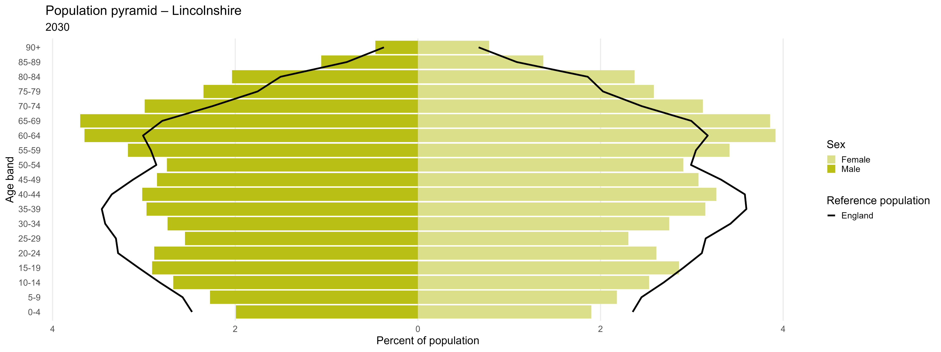
  Ageing population
By 2030, Lincolnshire’s population structure will become more steeply inverted and will still consist of a higher proportion of older people than in England.
Source: ONS Population Projections by Local Authority.

Slide 25
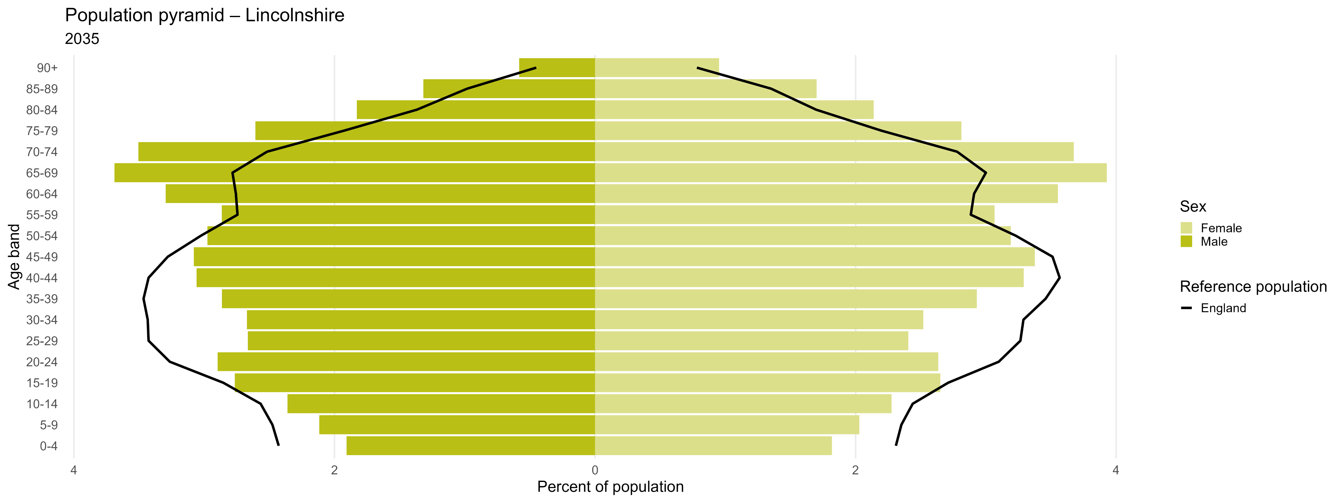
  Ageing population
By 2035, Lincolnshire’s population structure will become more steeply inverted and will still consist of a higher proportion of older people than in England.
Source: ONS Population Projections by Local Authority.

Slide 26
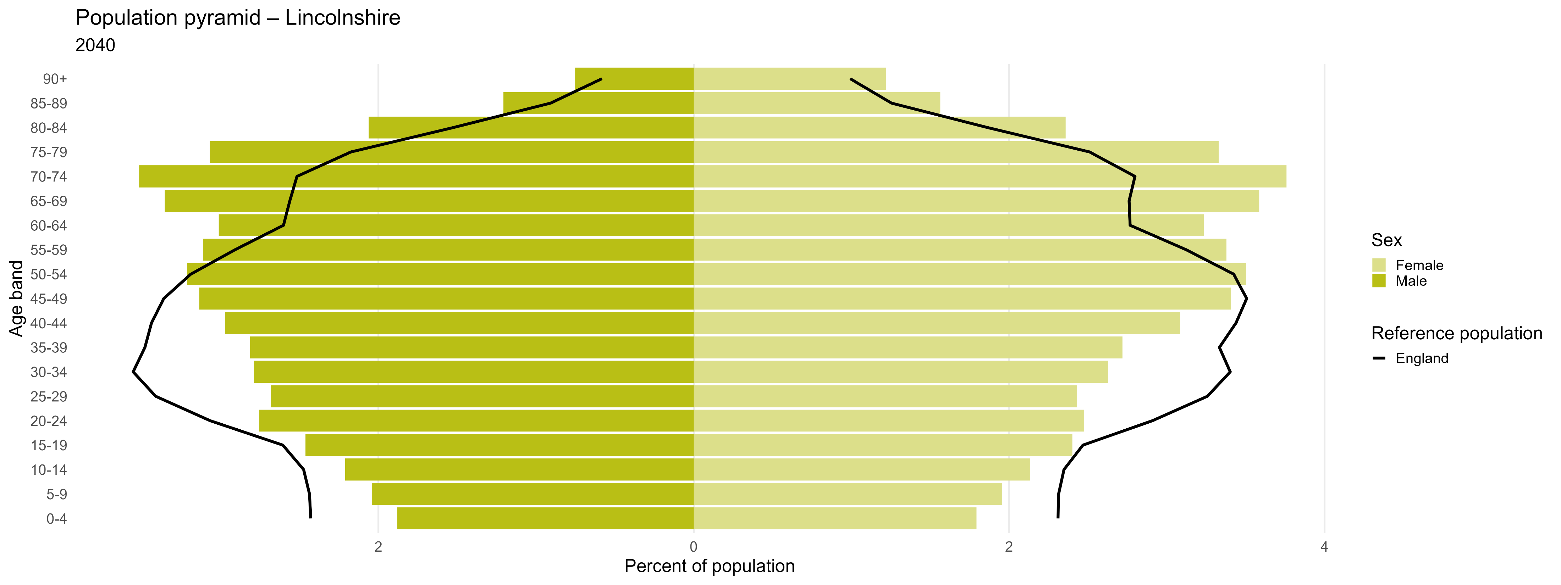
  Ageing population
By 2040, Lincolnshire’s population structure will become more steeply inverted and will still consist of a higher proportion of older people than in England.
Source: ONS Population Projections by Local Authority.

Slide 27
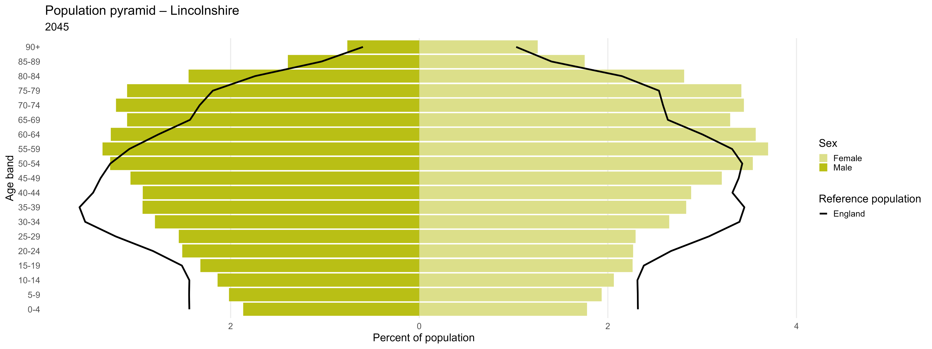
  Ageing population
By 2045, Lincolnshire’s population structure will become more steeply inverted and will still consist of a higher proportion of older people than in England.
Source: ONS Population Projections by Local Authority.

Slide 28
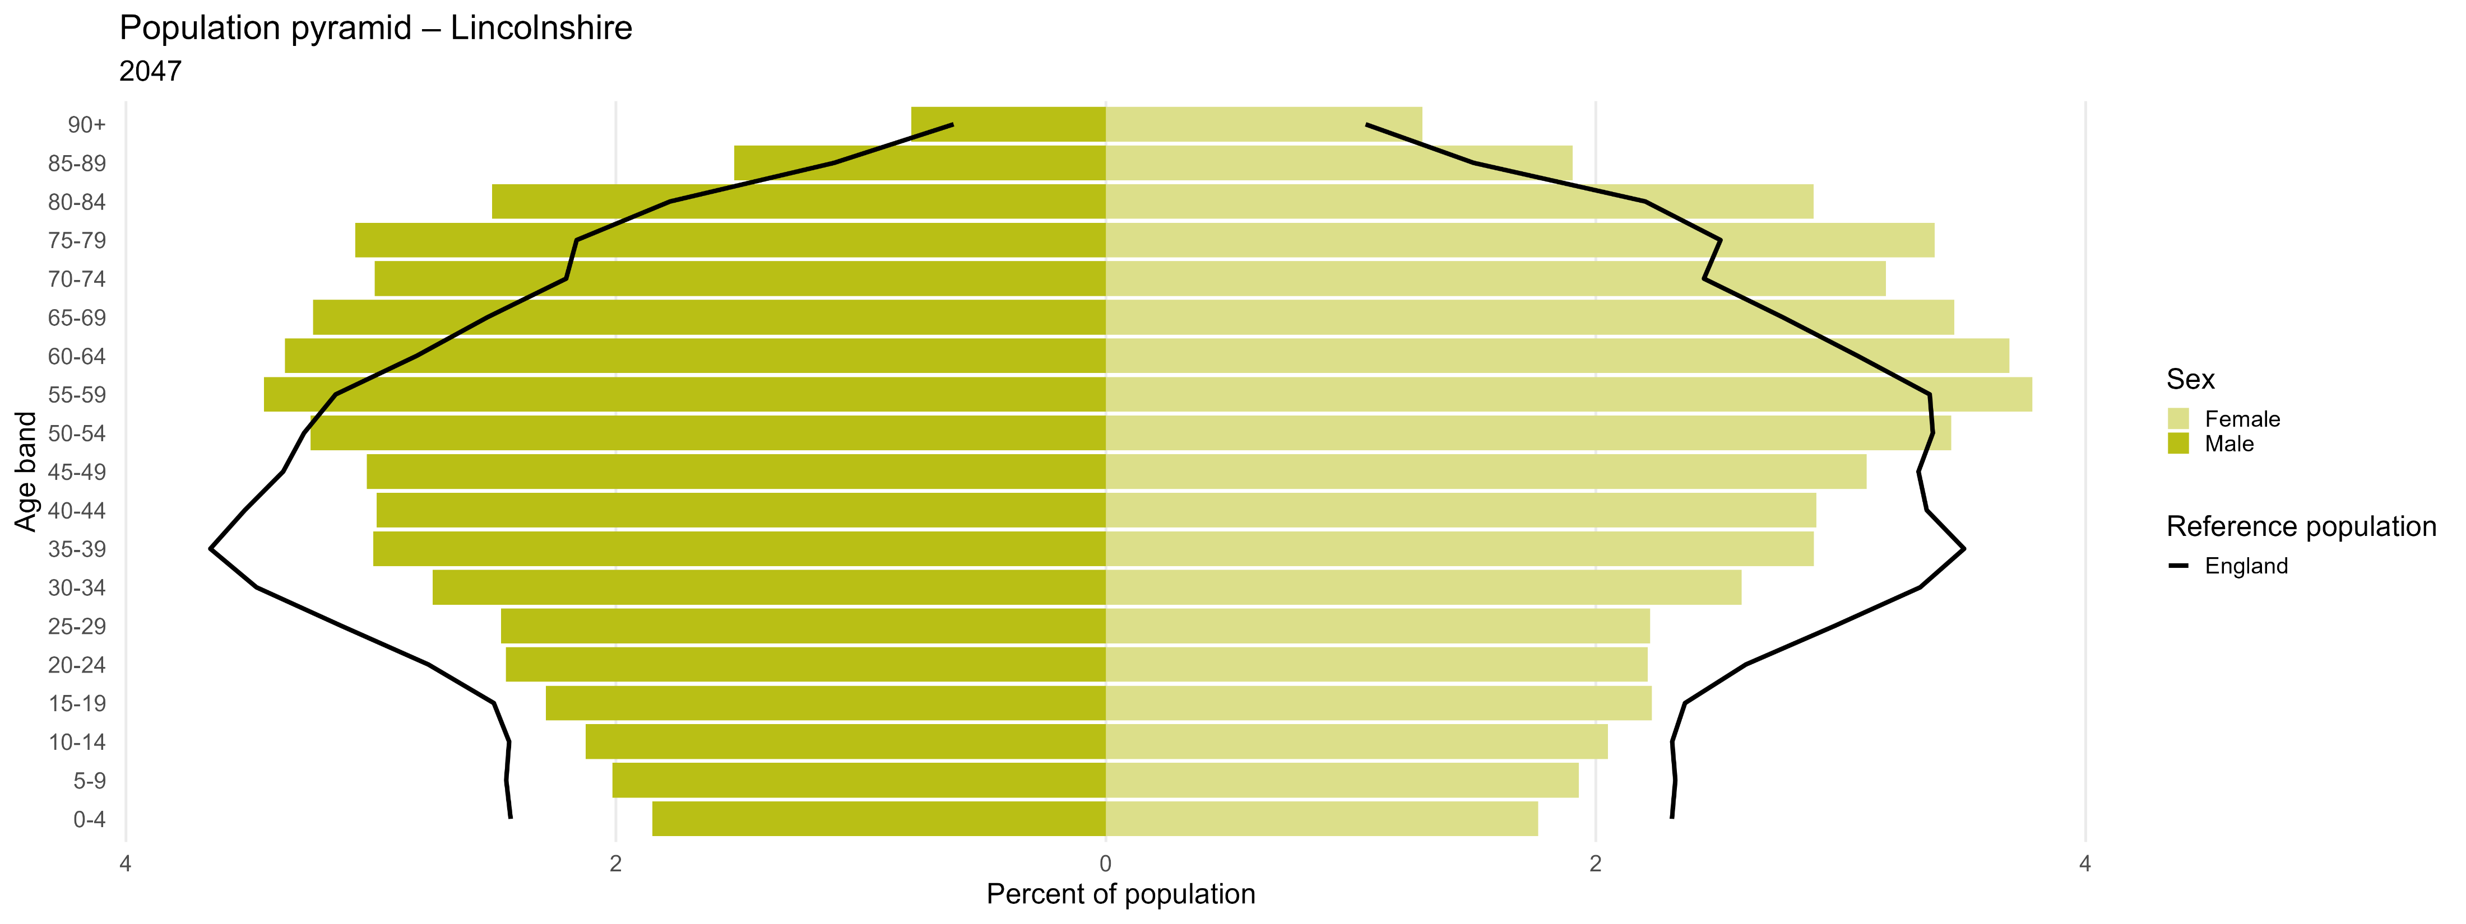
  Ageing population
By 2047, Lincolnshire’s population structure will become more steeply inverted and will still consist of a higher proportion of older people than in England.
Source: ONS Population Projections by Local Authority.

Slide 29
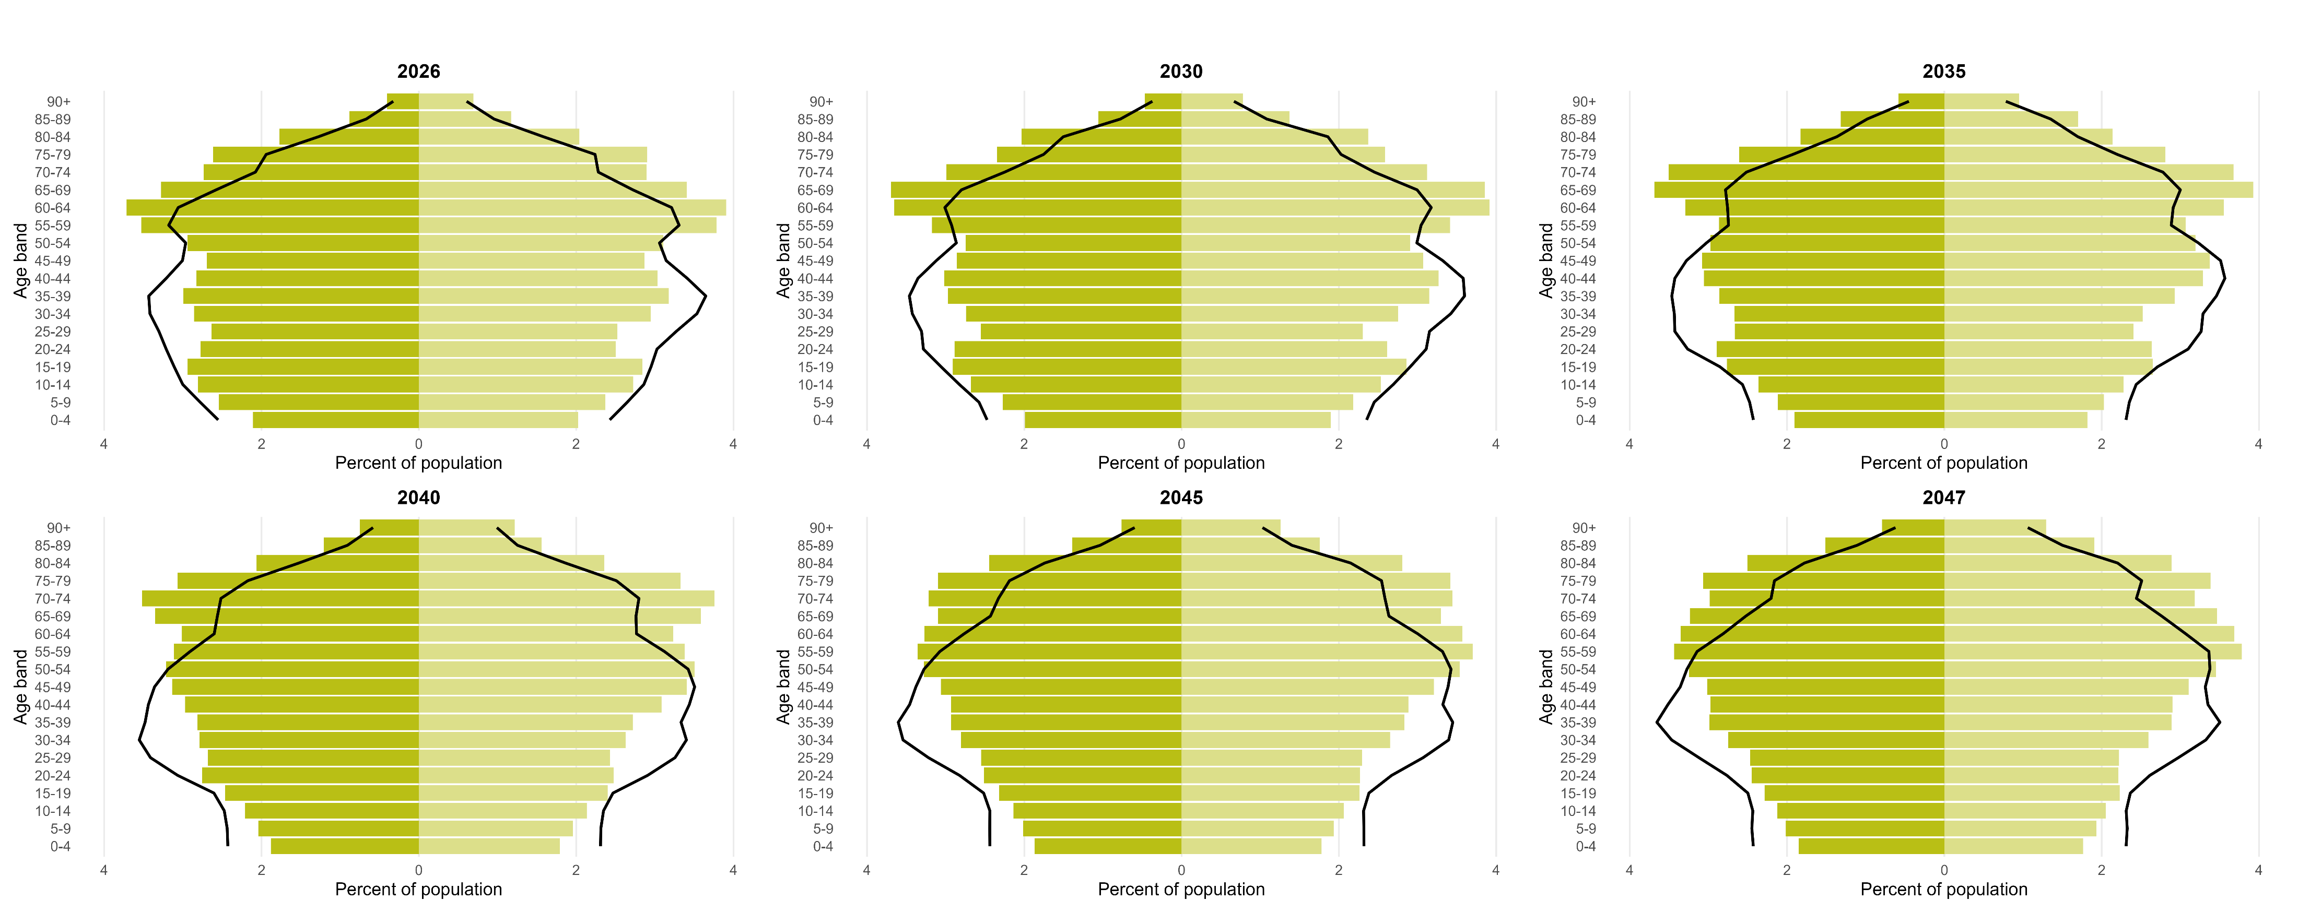
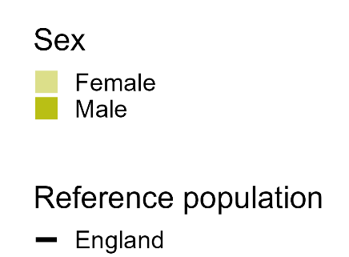
  Ageing population
By 2047, Lincolnshire’s population structure will become more steeply inverted and will still consist of a higher proportion of older people than in England.
Source: ONS Population Projections by Local Authority.

Slide 30
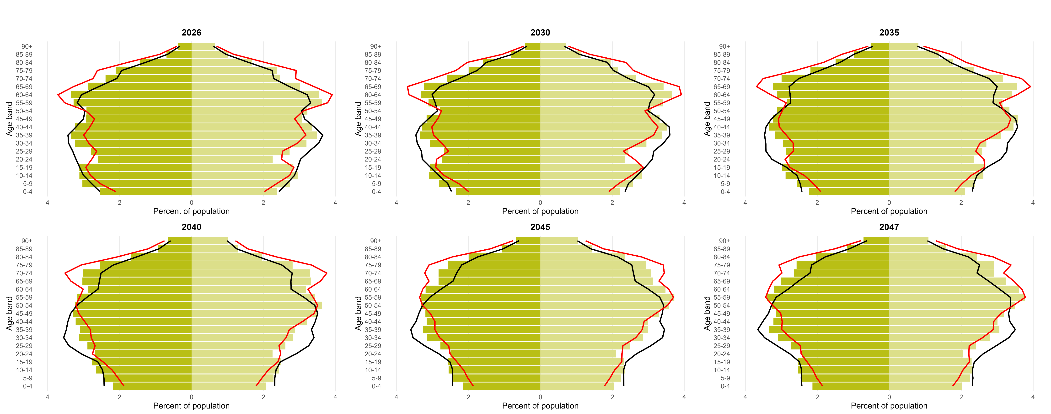
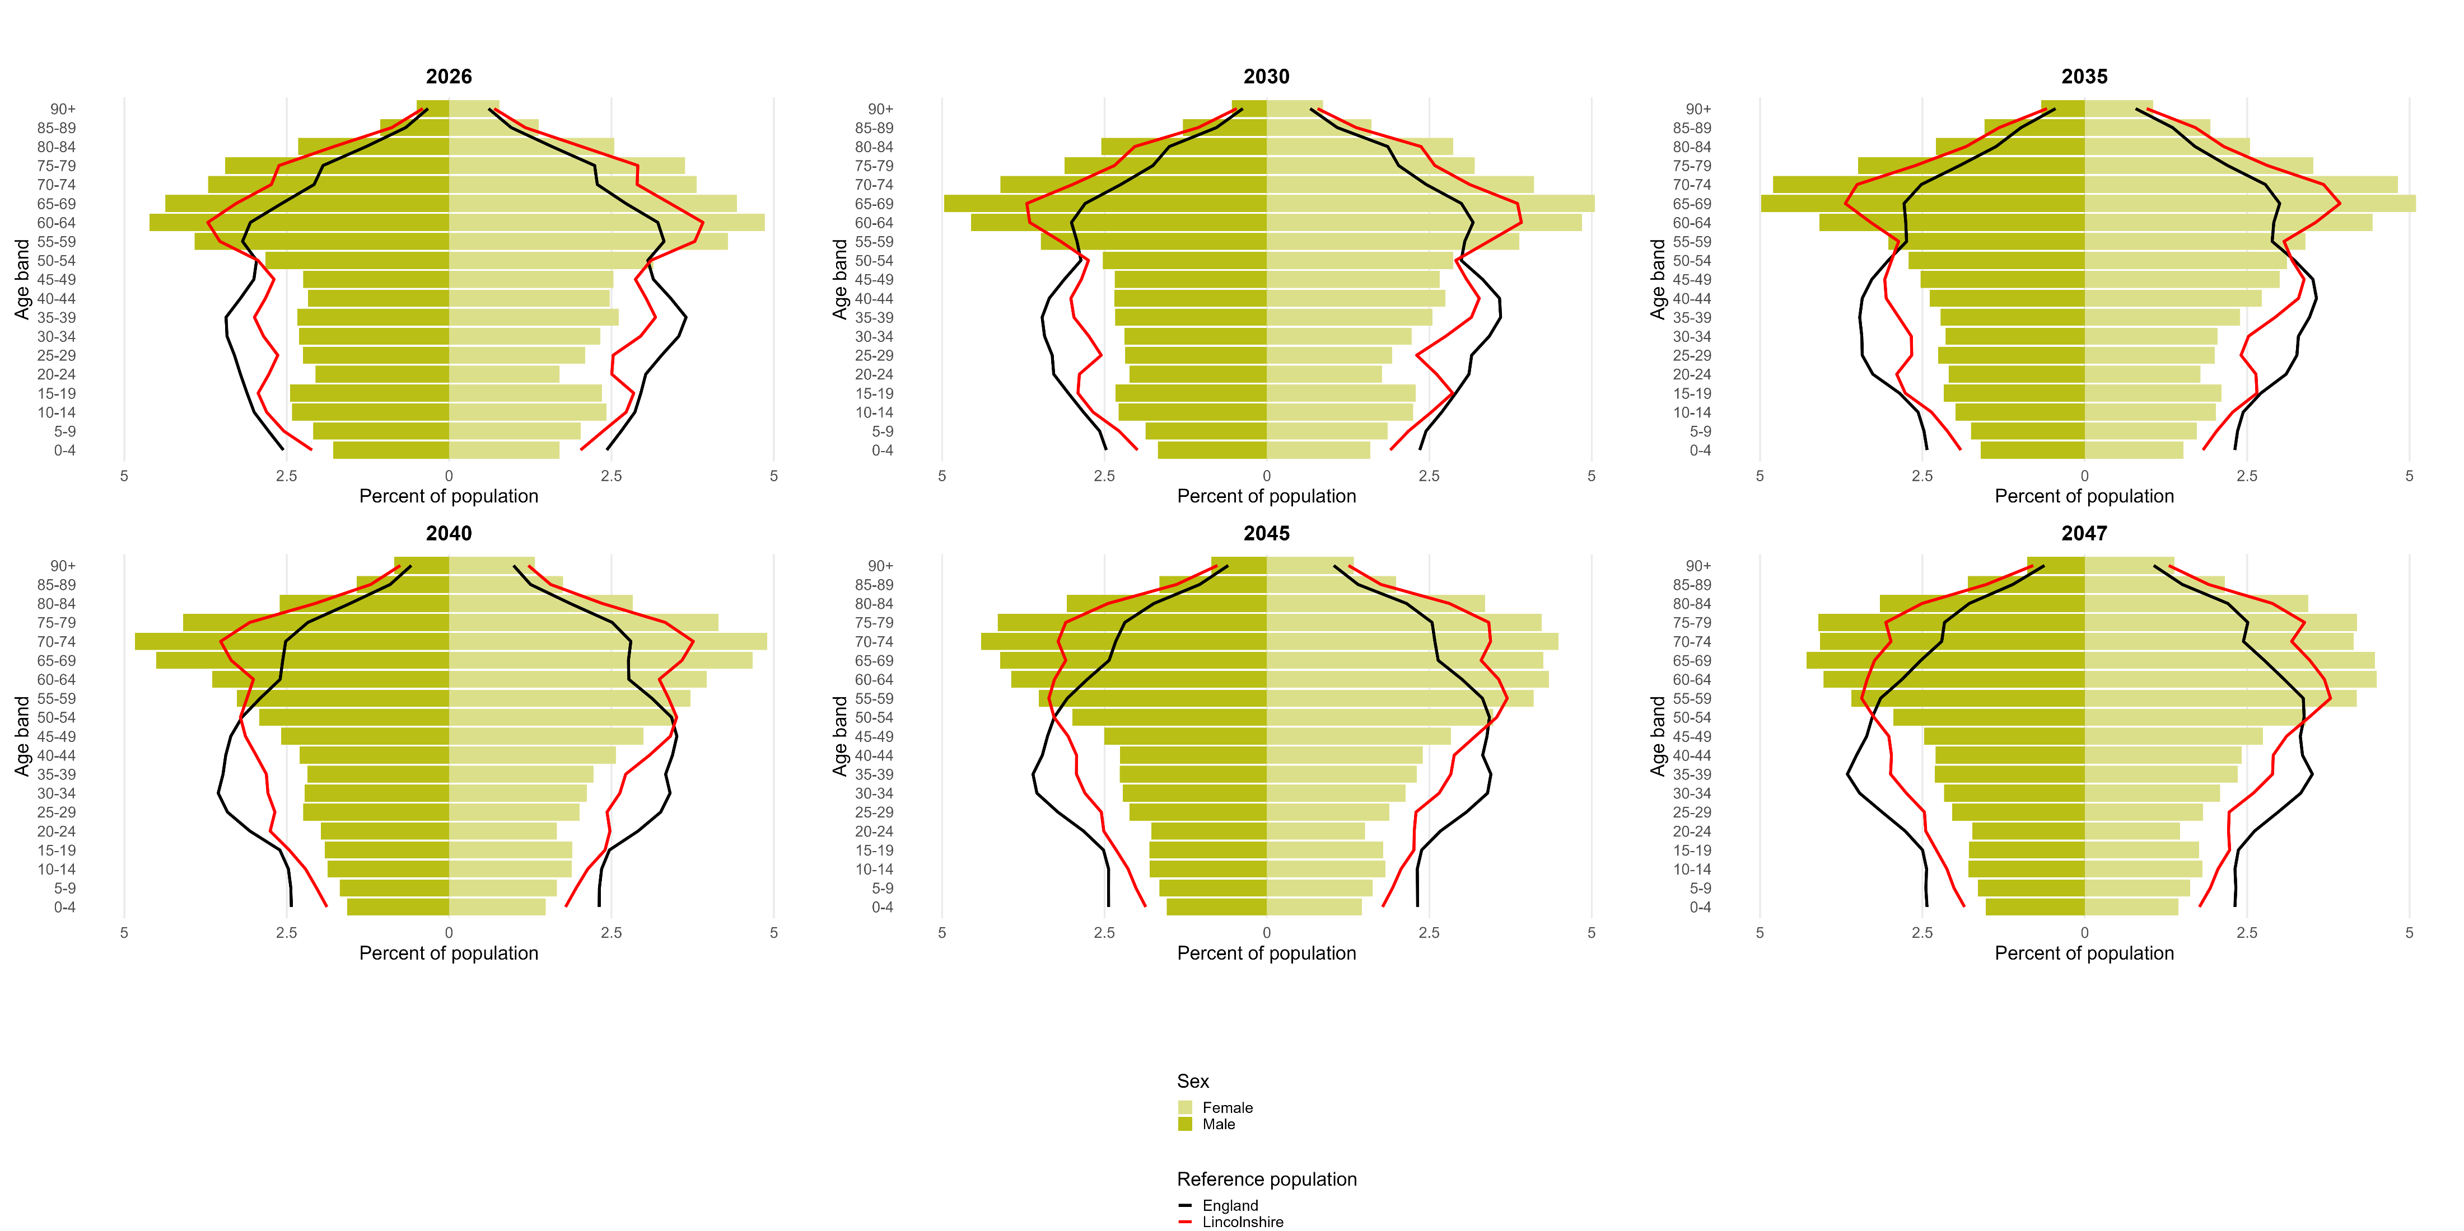
  Ageing population
Boston has a higher proportion of children and lower proportion of adults over 65 than the rest of Lincolnshire.
Source: ONS Population Projections by Local Authority.

Slide 31
  Ageing population
East Lindsey’s population structure is older than England’s and Lincolnshire’s, and this will remain the case over the next 20 years.
Source: ONS Population Projections by Local Authority.

Slide 32
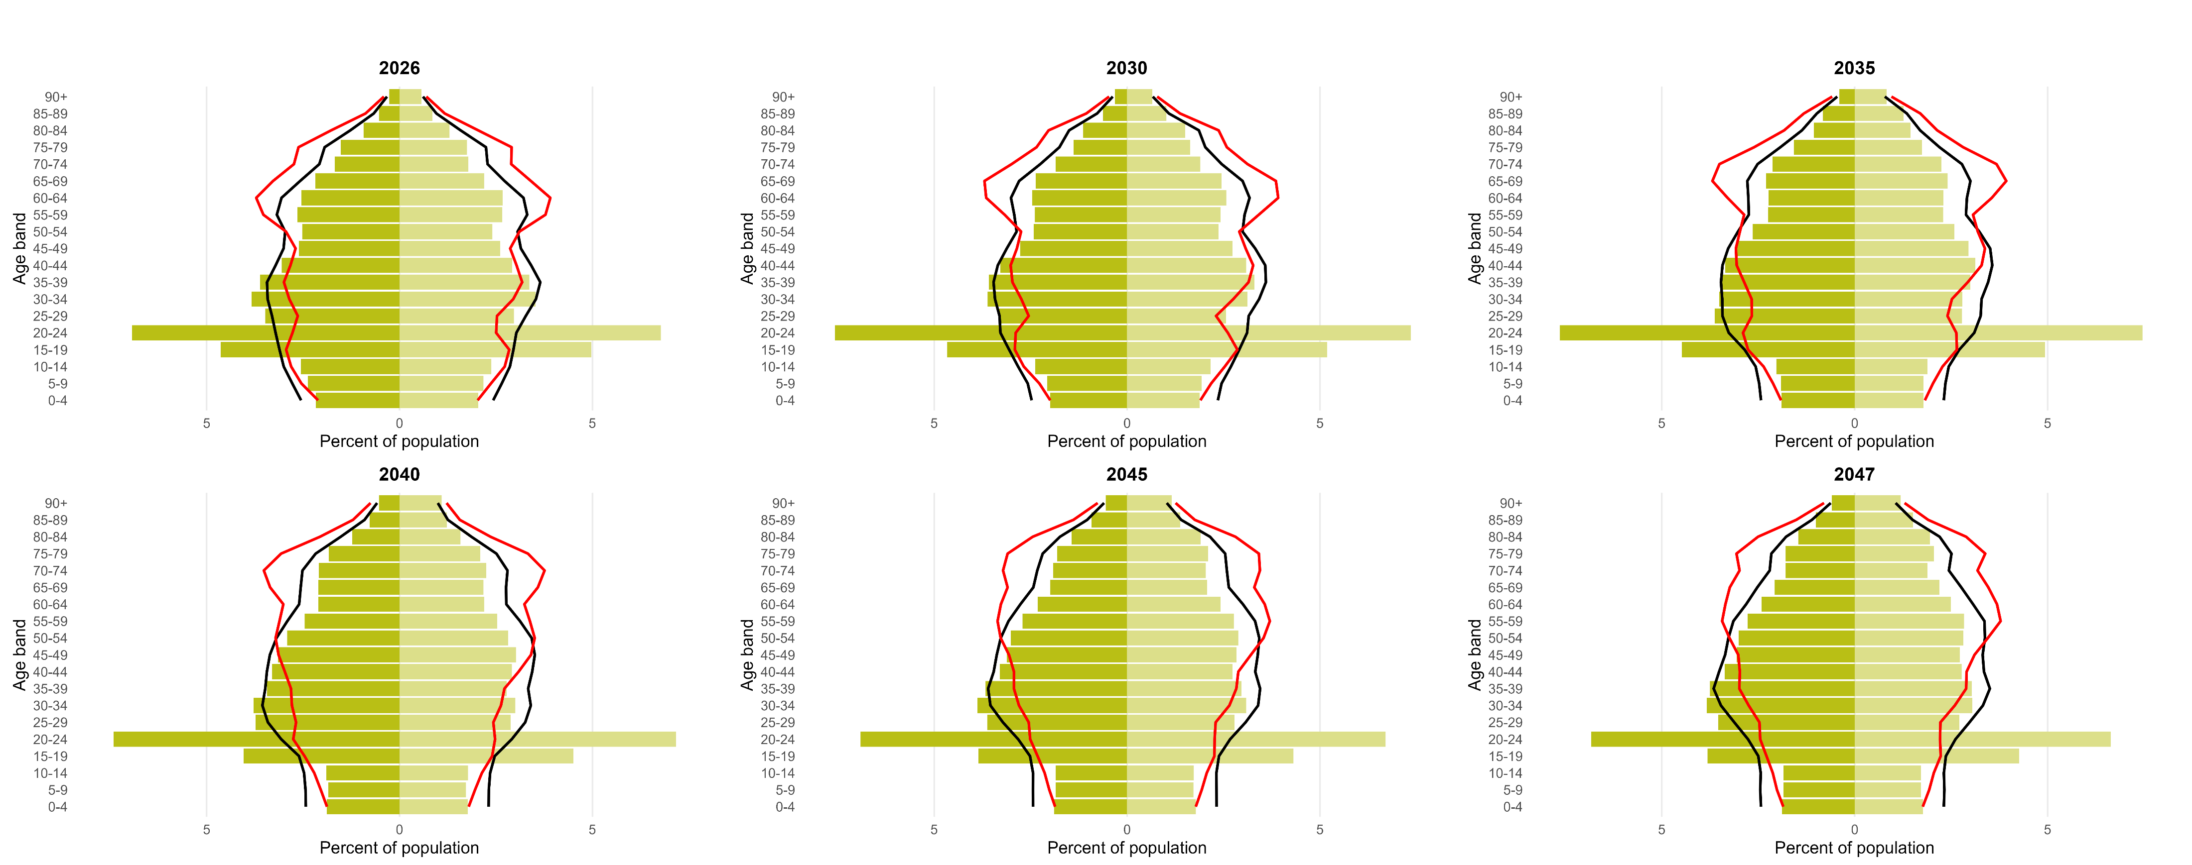
  Ageing population
Lincoln has a larger proportion of young people than England and Lincolnshire, due to ~20k students attending its universities.
Source: ONS Population Projections by Local Authority.

Slide 33
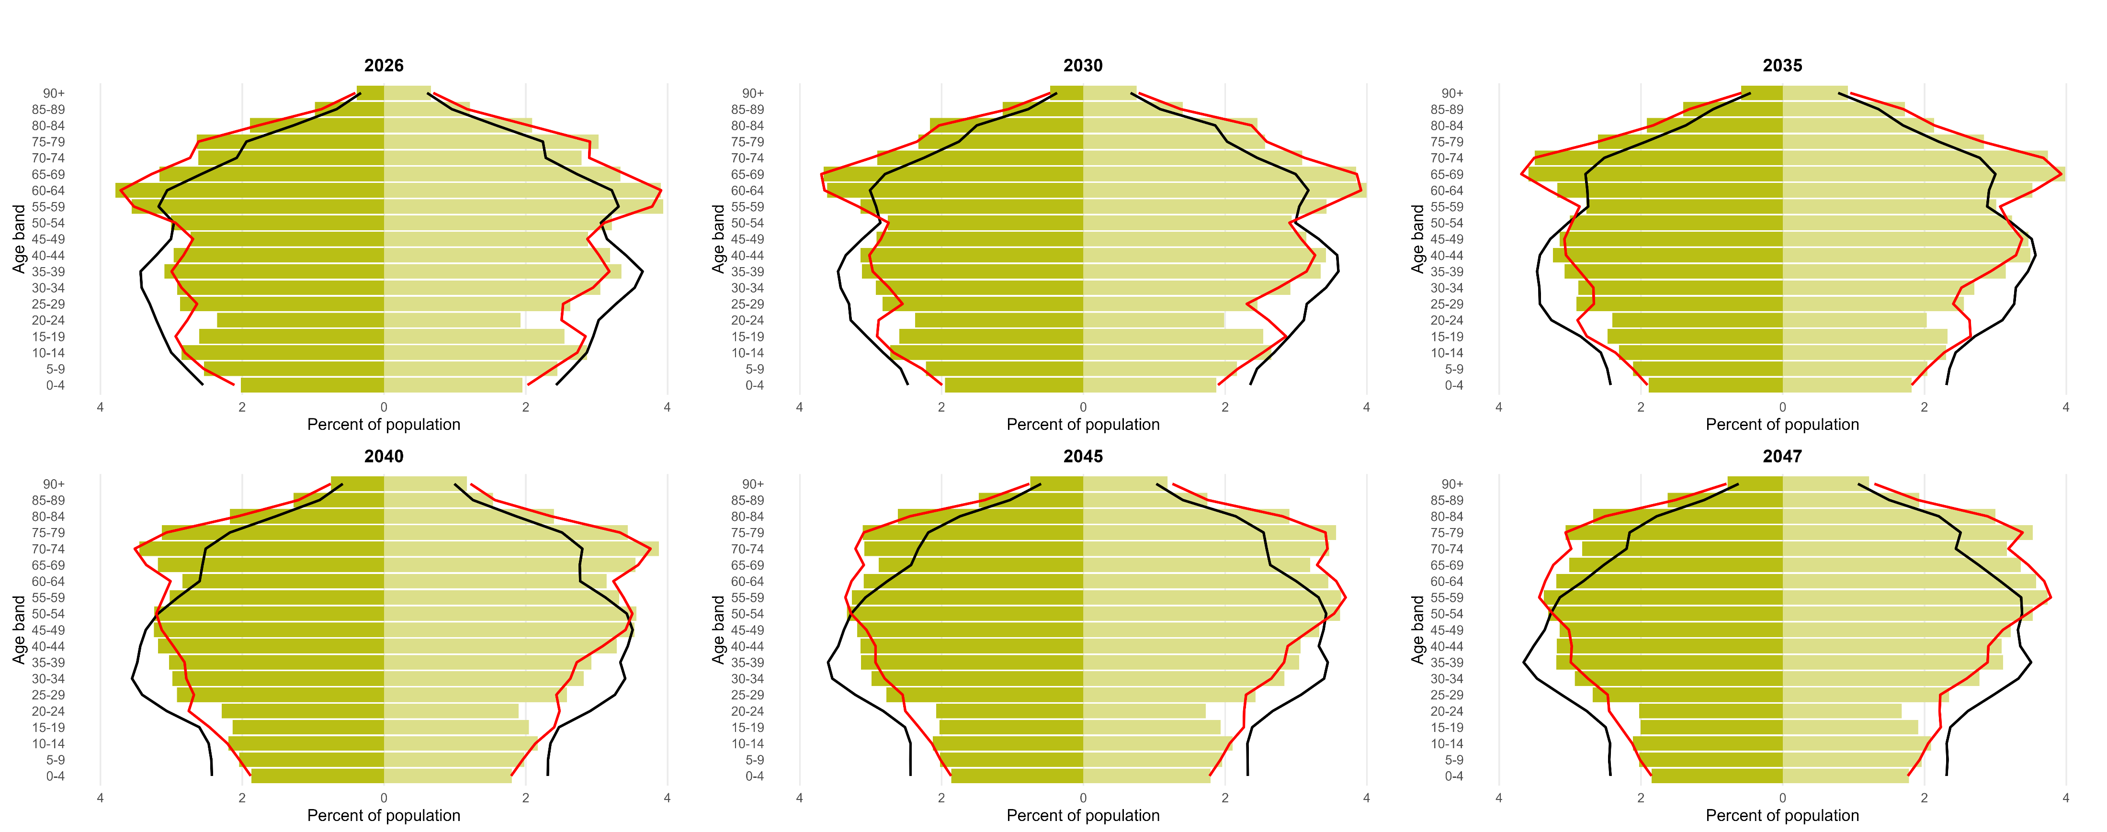
  Ageing population
North Kesteven has an old population with a larger proportion of its population consisting of over 50s than across England.
Source: ONS Population Projections by Local Authority.

Slide 34
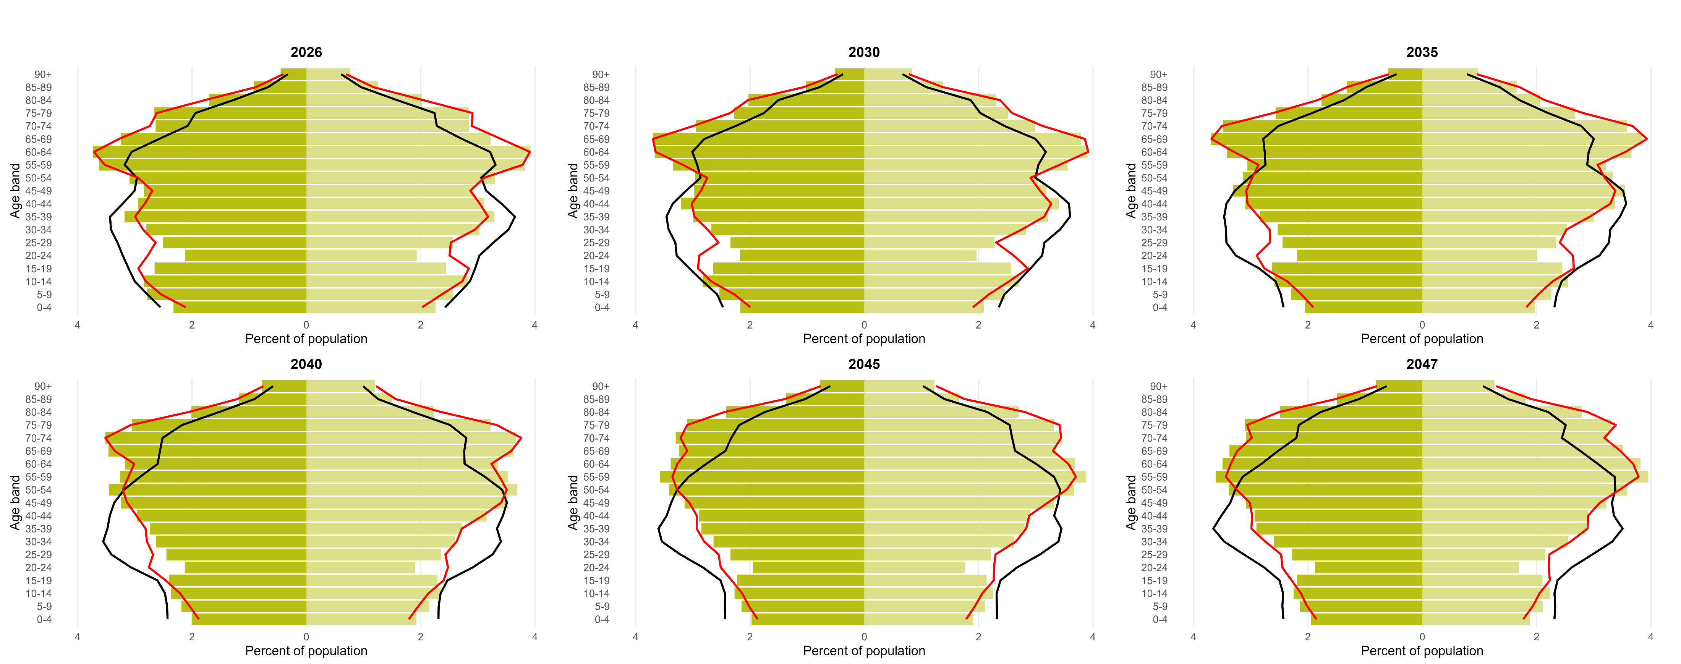
  Ageing population
South Kesteven’s has an old population with a larger proportion of its population consisting of over 50s than across England.
Source: ONS Population Projections by Local Authority.

Slide 35
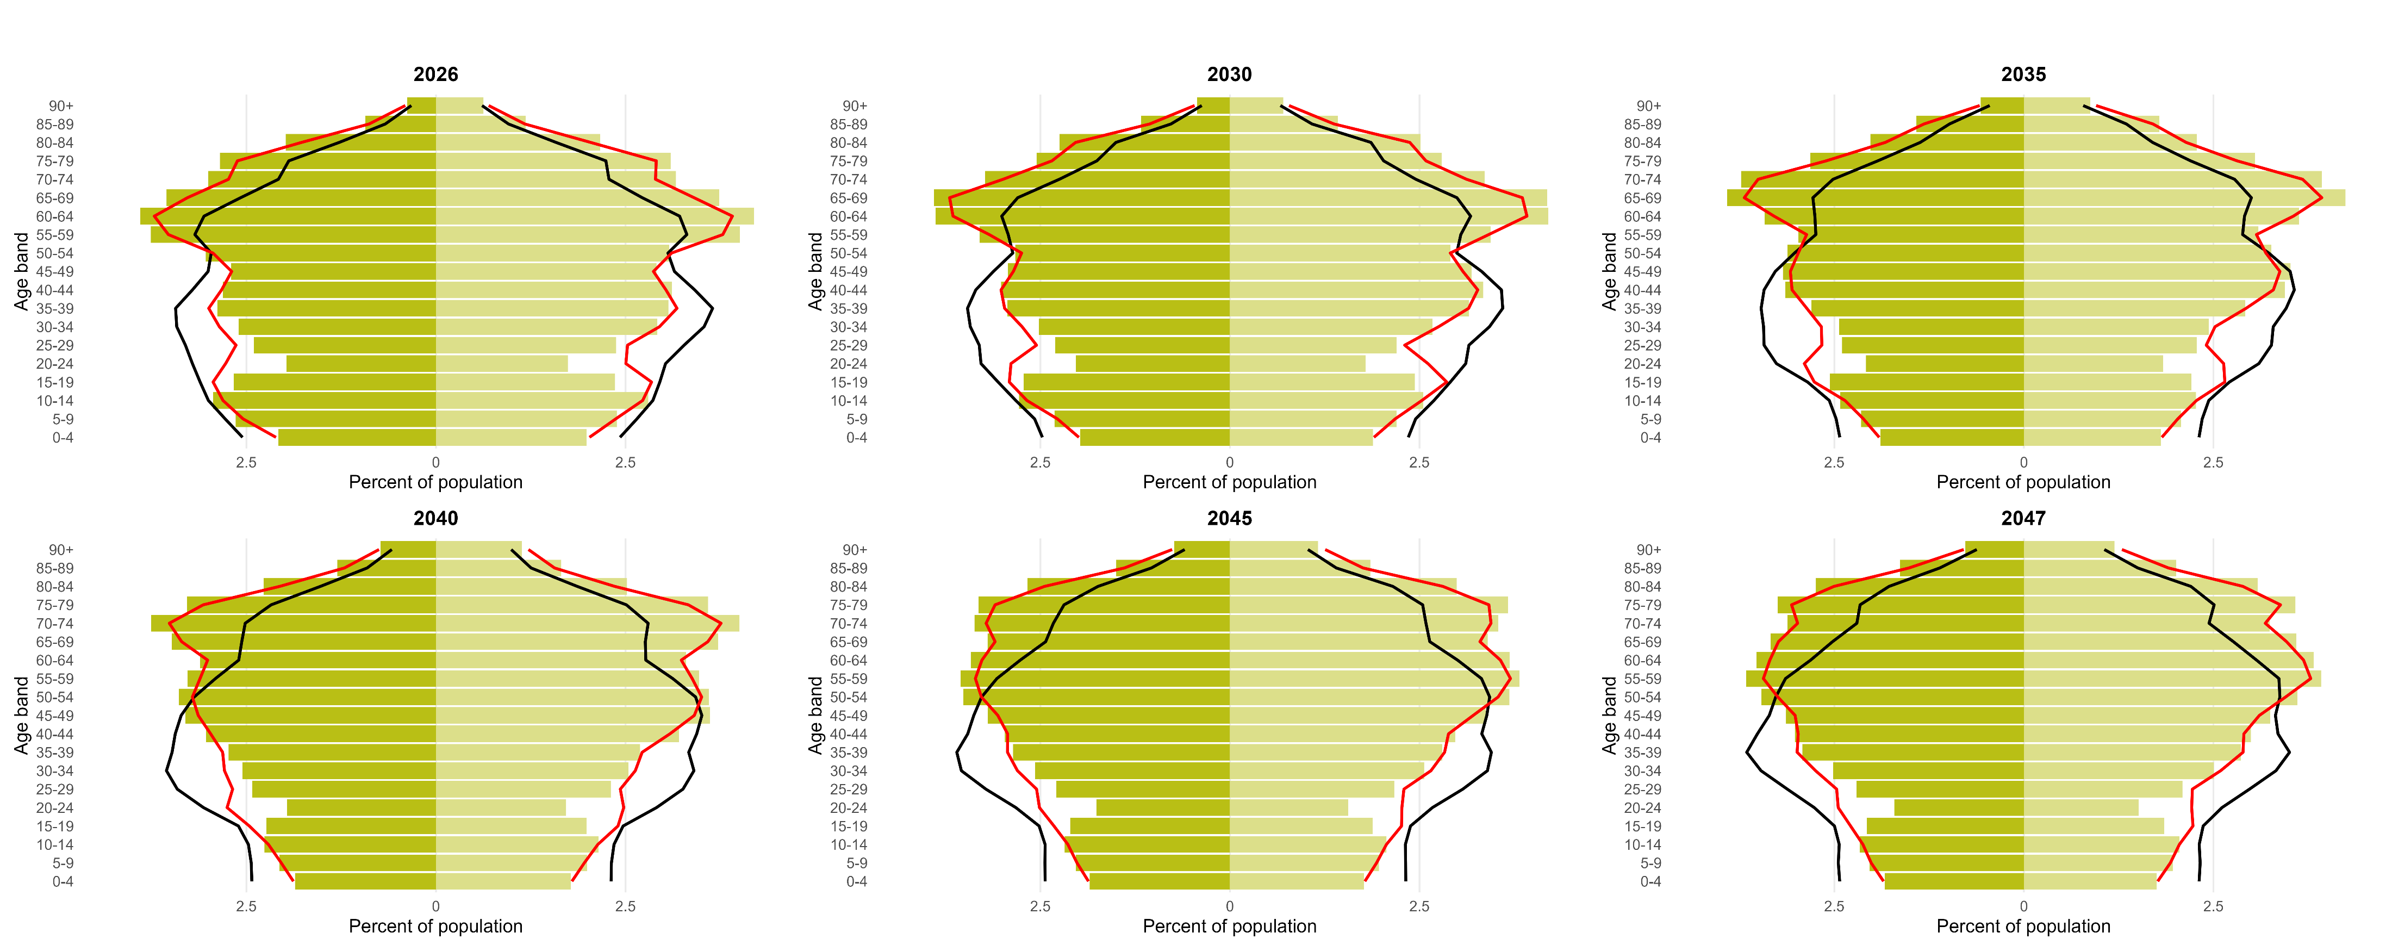
  Ageing population
West Lindsey has an old population with a larger proportion of its population consisting of over 50s than across England.
Source: ONS Population Projections by Local Authority.

Slide 36
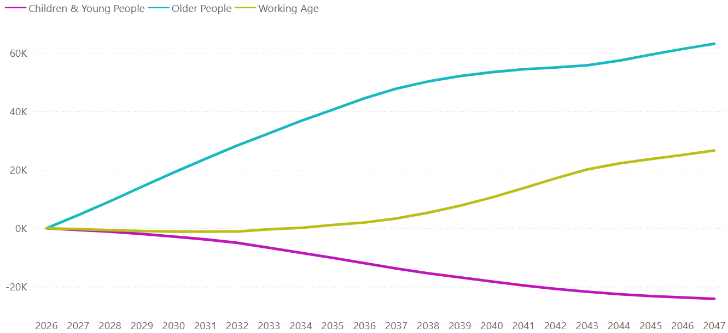
  Ageing population
By 2047, Lincolnshire is expected to be home to 24k fewer Children & Young People, 27k more Working Age People and 63k more Older People.
Population change projected by age group (2026 to 2047)
Source: ONS Population Projections by Local Authority.
Note: Children & Young People are 0-24 years old; Working Age are 25-64 years old; Older people are 65+ years old.

Slide 37

Burden of Disease in Lincolnshire

Slide 38
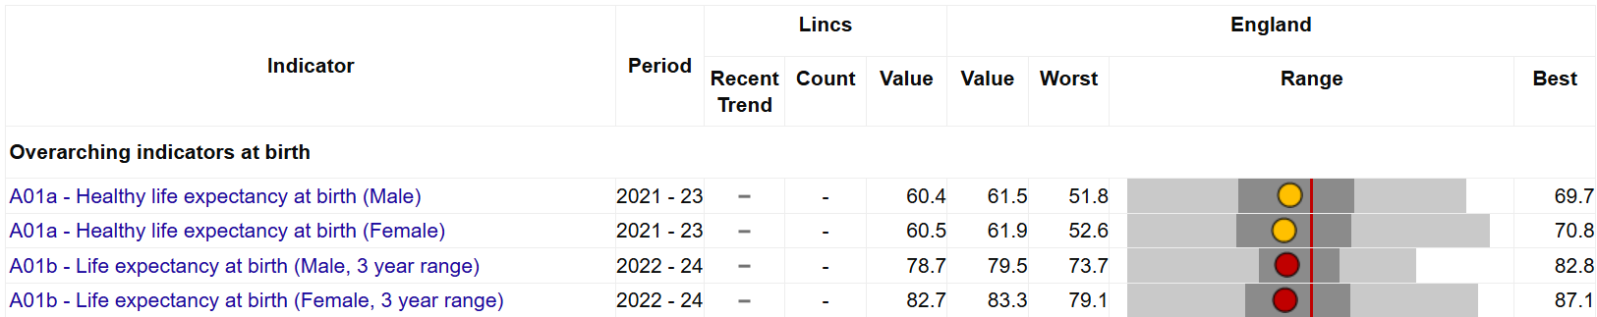

  Life expectancy
Healthy life expectancy in Lincolnshire is similar to the national median, but overall life expectancy is worse.
Source: Fingertips, OHID, based on Office for National Statistics data

Slide 39
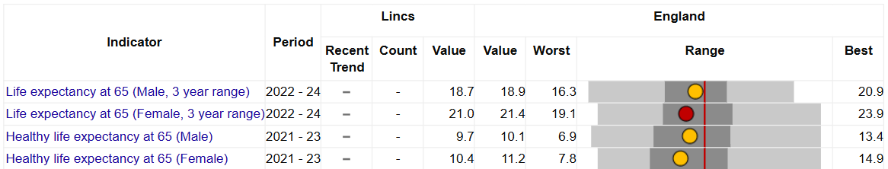
  Life expectancy
Healthy life expectancy at 65 in Lincolnshire is similar to the national median, but life expectancy at 65 is worse for women.
Source: Fingertips, OHID, based on Office for National Statistics data

Slide 40
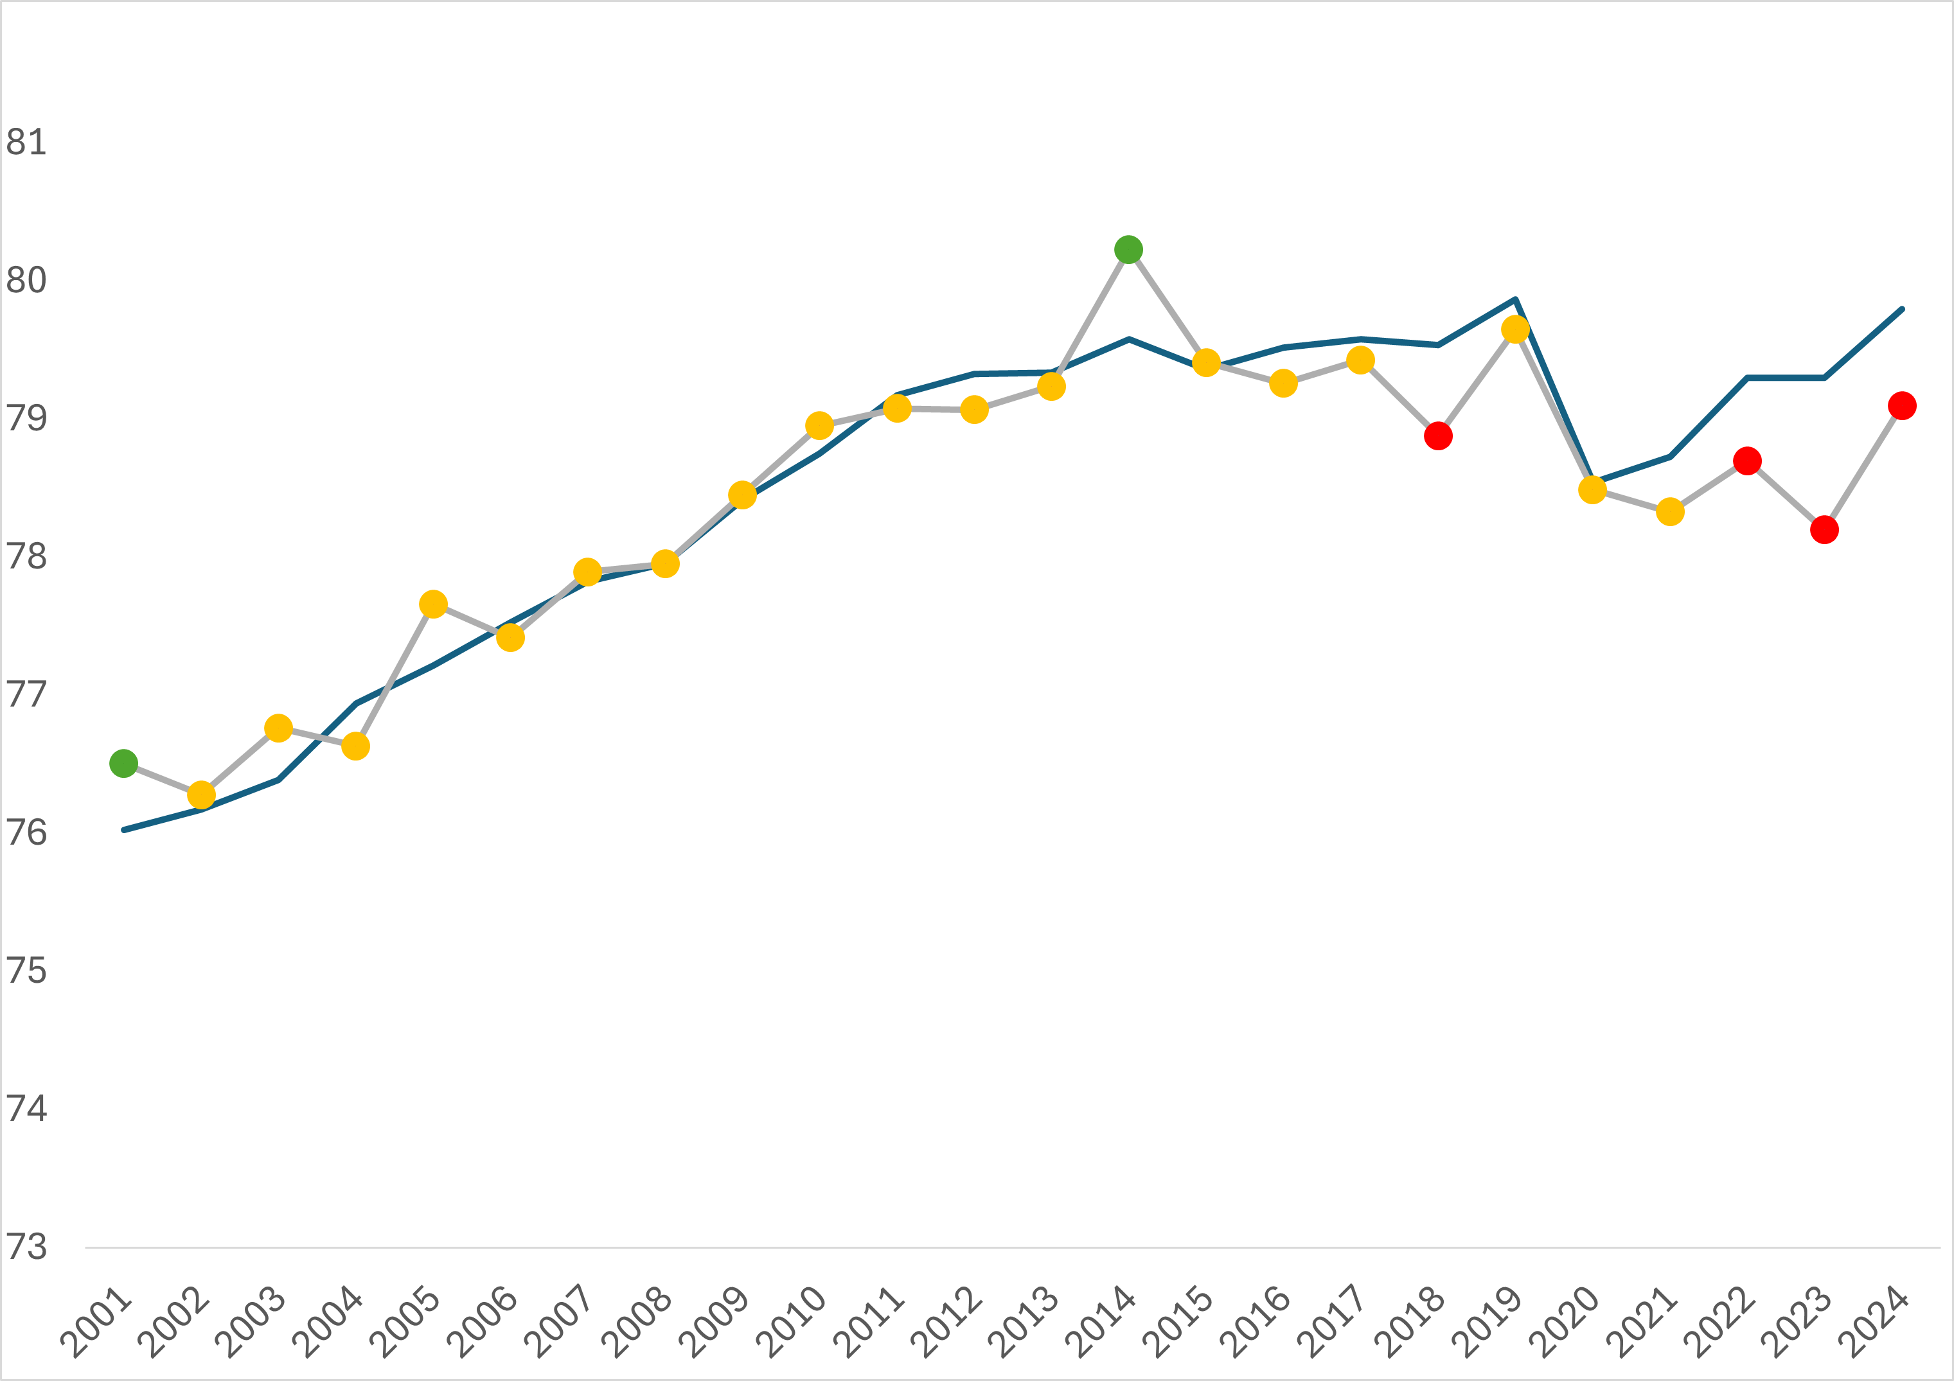
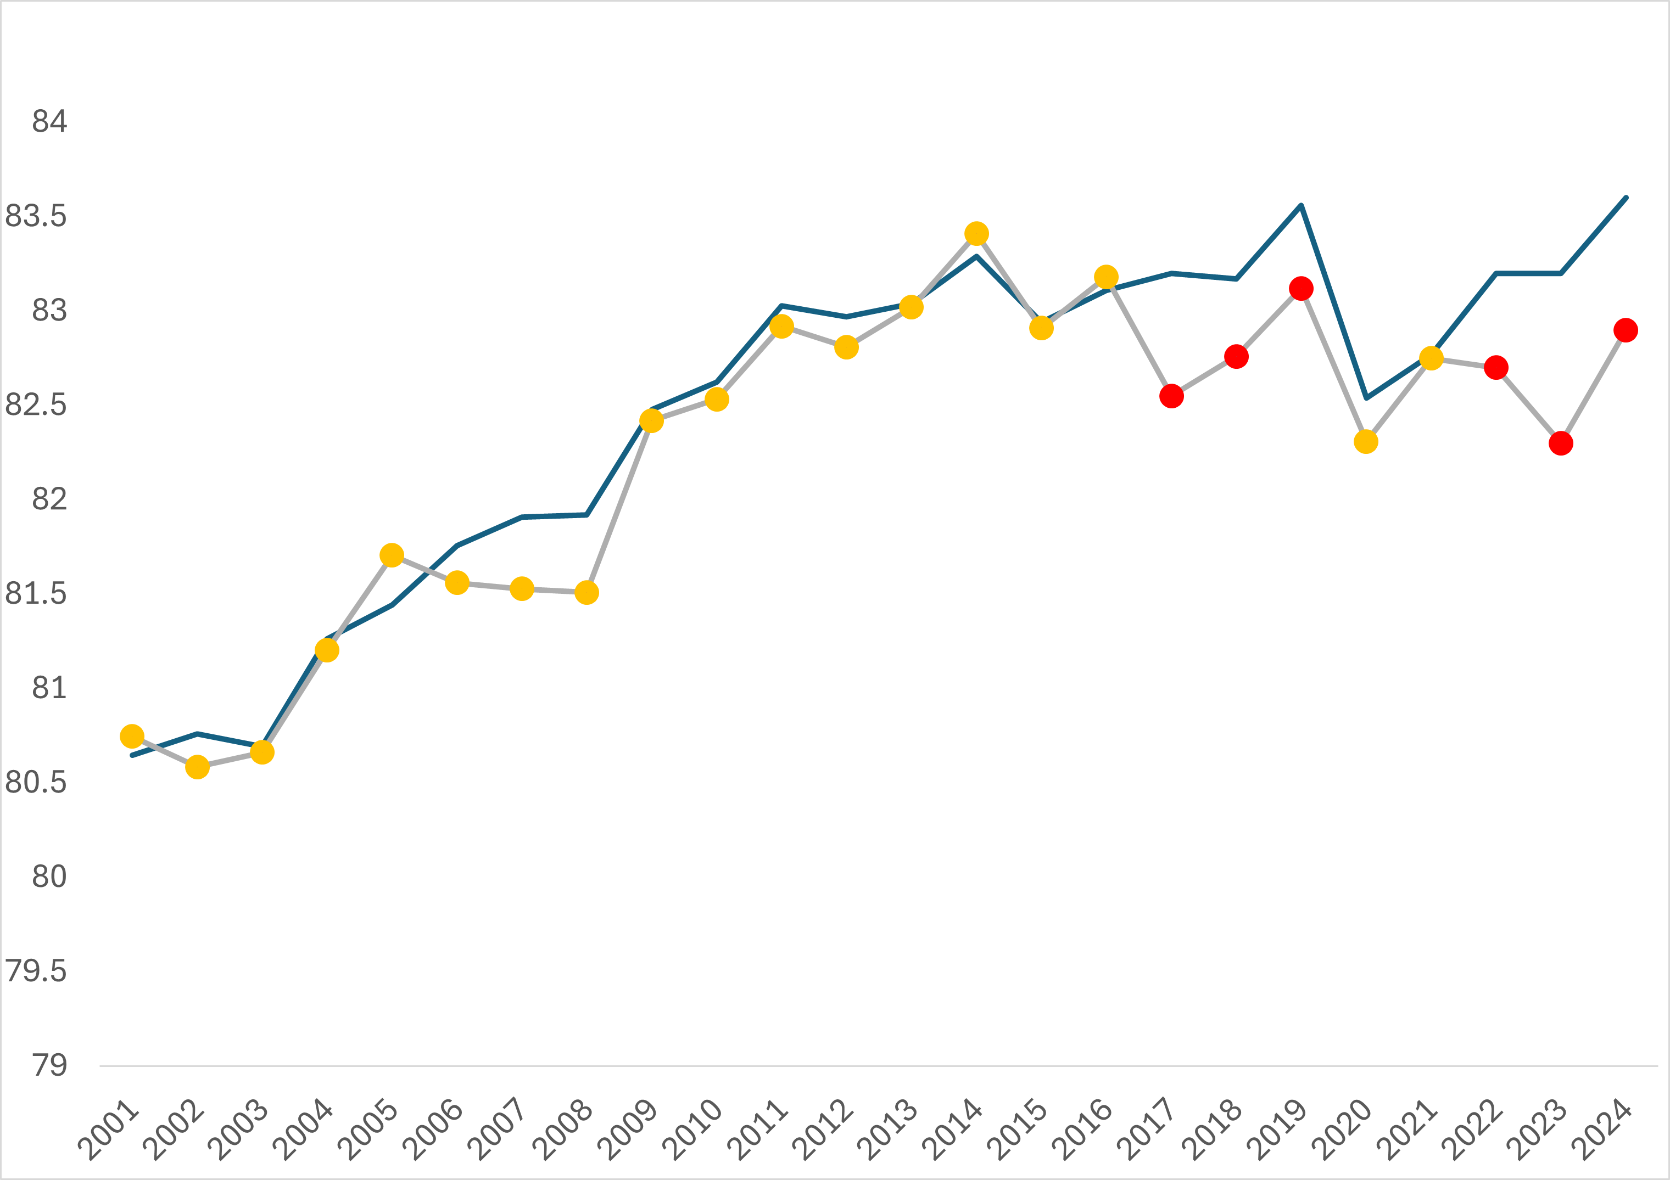
  Life expectancy
Life expectancy among men and women in Lincolnshire has been worse than the England average for 3 consecutive years.
0.8-year gap
(2022-2024)
0.6-year gap
(2022-2024)
Lincolnshire
England
Lincolnshire
England
Source: Fingertips, OHID, based on Office for National Statistics data

Slide 41
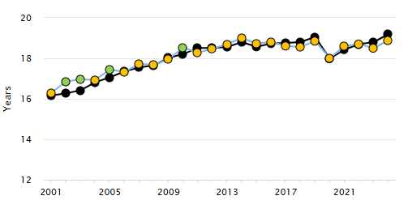
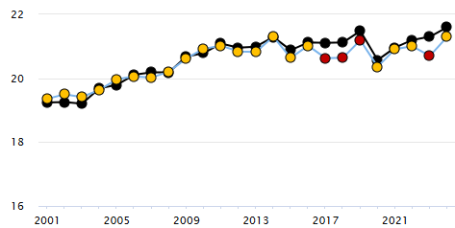
  Life expectancy
Life expectancy at 65 among men has closely followed national trends, but among women it has occasionally been worse – significantly so over the last 3 years.
Life expectancy at 65 (Male, 1 year range)
Life expectancy at 65 (Female, 1 year range)
0.2-year gap
(2022-2024)
0.4-year gap
(2022-2024)
Lincolnshire
England
Lincolnshire
England
Source: Fingertips, OHID, based on Office for National Statistics data

Slide 42
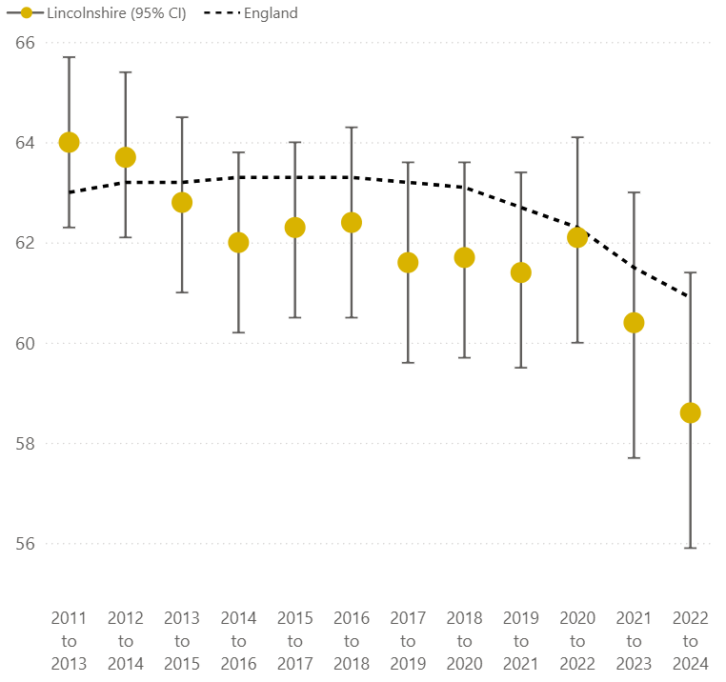
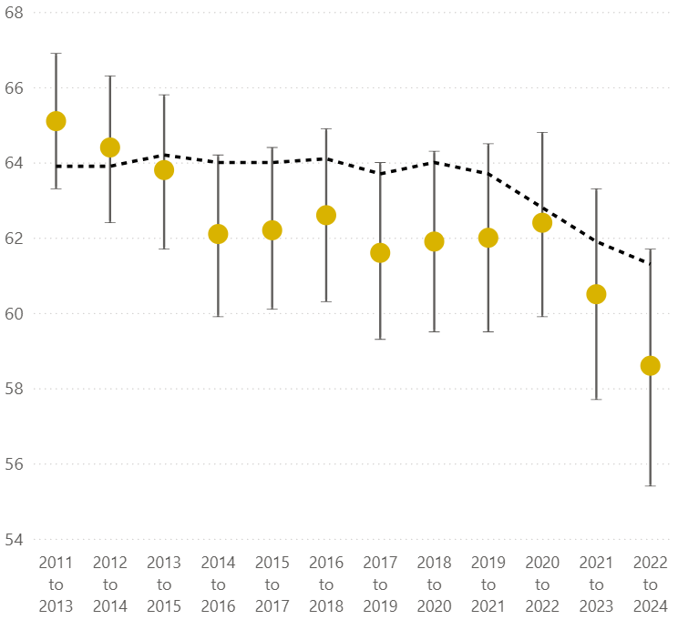
  Healthy life expectancy
Healthy life expectancy in Lincolnshire is lower now than it was in the early 2010s –
a trend that is reflected nationally.
Healthy Life Expectancy at birth (Male, 3-year range)
Healthy Life Expectancy at birth (Female, 3-year range)
Source: Fingertips, OHID, based on Office for National Statistics data

Slide 43
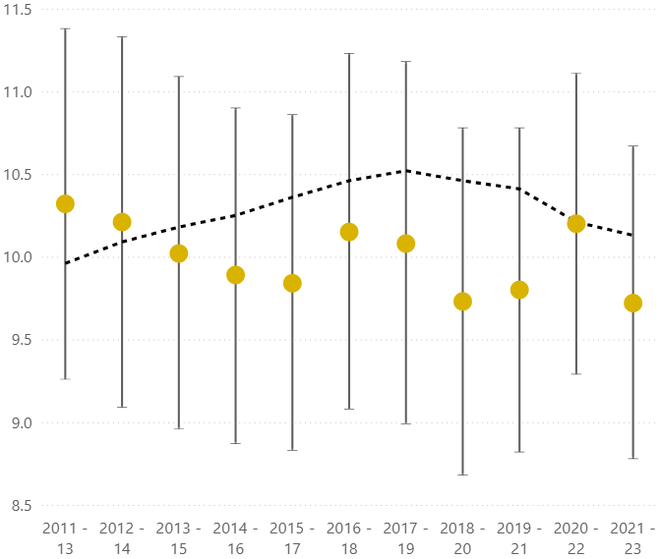
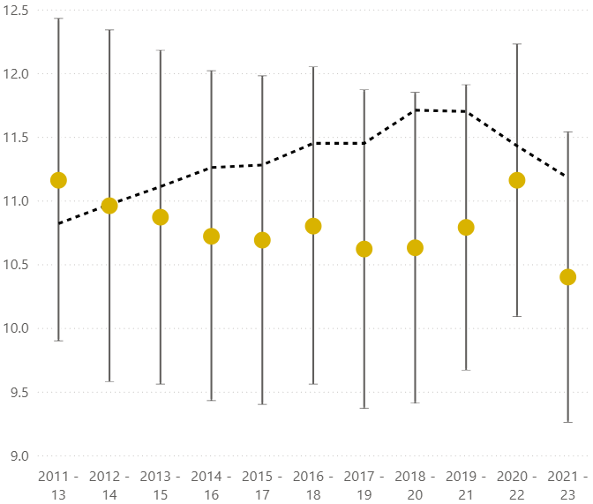
  Healthy life expectancy
Healthy life expectancy at 65 in Lincolnshire has not changed significantly since the early 2010s and has been consistently in line with the national median.
Healthy Life Expectancy at 65 (Male, 3-year range)
Healthy Life Expectancy at 65 (Female, 3-year range)
Source: Fingertips, OHID, based on Office for National Statistics data

Slide 44
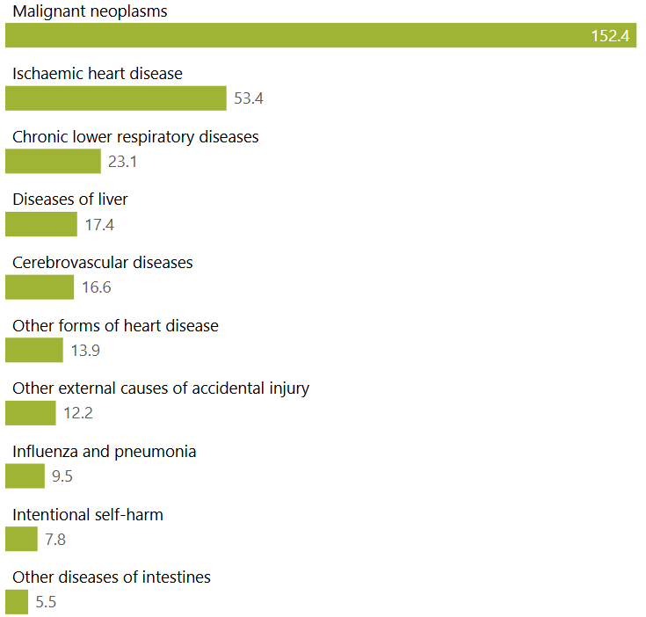
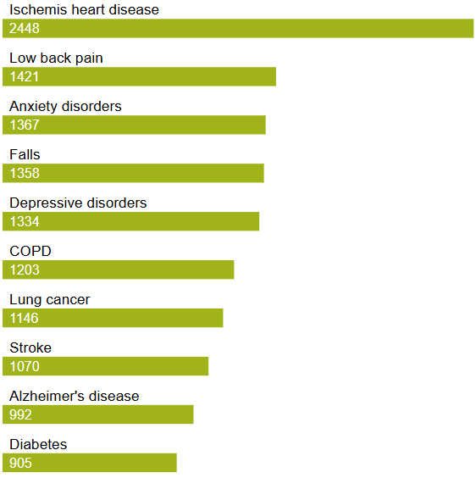
  Preventable premature mortality and morbidity
Lifestyle-related diseases feature heavily as causes of premature death and disability.
Top 10 causes of premature death (under 75), deaths per 100,000 people under 75 per year, Lincolnshire¹
Top 10 causes of DALYs per 100,000 registered people per year, East Midlands²
Sources: (1) Lincolnshire Data Management Environment (not externally accessible). November 2022 to October 2025. (2) Institute for Health Metrics and Evaluation (IHME). GBD Compare Data Visualization. Seattle, WA: IHME, University of Washington, 2025. Available from https://vizhub.healthdata.org/gbd-compare. (Accessed Feb 2026)

Slide 45
  Preventable premature mortality
Years of Life Lost by Cause in Lincolnshire (2021)
In 2021, there were 155k years of life lost in Lincolnshire. The leading causes of this loss were Neoplasms, Cardiovascular Diseases and (due to COVID-19) Respiratory Infections.
Other substantial causes contributing to lost years of life were Chronic Respiratory Diseases, Neurological Disorders and Digestive Diseases.
Neoplasms
30%
Cardiovascular diseases
22%
Respiratory Infections & TB
18%
Chronic Respiratory diseases 7%
Neurological Disorders
6%
Diabetes & Kidney disease
2%
Digestive Diseases 5%
2%
2%
Other 6%
Self harm + interpersonal violence
Unintentional injury
Sources: Institute for Health Metrics and Evaluation (IHME). GBD Compare Data Visualization. Seattle, WA: IHME, University of Washington, 2023. Available from https://vizhub.healthdata.org/gbd-compare. (Accessed Feb 2026)

Slide 46
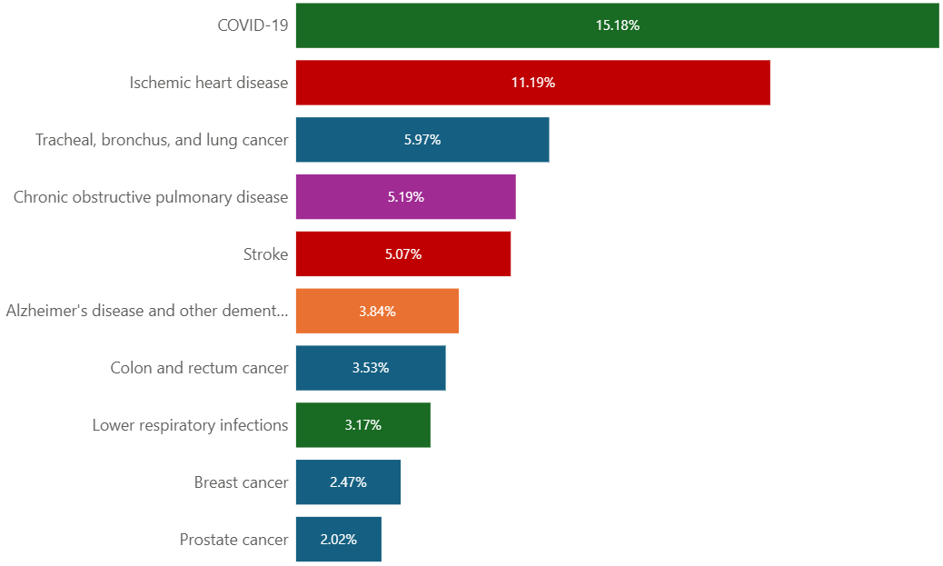
  Preventable premature mortality
Years of Life Lost by Cause in Lincolnshire (2021)
Top 10 Sub-Causes of Years of Life Lost in Lincolnshire (2021)
Neoplasms
30%
Cardiovascular diseases
22%
Respiratory Infections & TB
18%
Chronic Respiratory diseases 7%
Neurological Disorders
6%
Diabetes & Kidney disease
2%
Digestive Diseases 5%
2%
2%
Other 6%
Self harm + interpersonal violence
Unintentional injury
Sources: Institute for Health Metrics and Evaluation (IHME). GBD Compare Data Visualization. Seattle, WA: IHME, University of Washington, 2023. Available from https://vizhub.healthdata.org/gbd-compare. (Accessed Feb 2026)

Slide 47
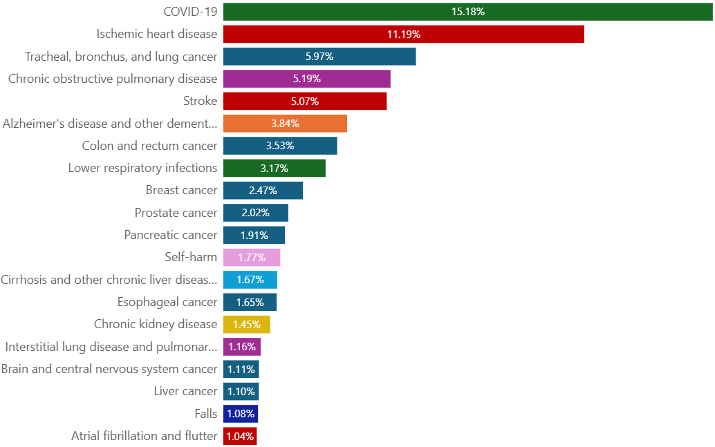
  Preventable premature mortality
Years of Life Lost by Cause in Lincolnshire (2021)
Top 20 Sub-Causes of Years of Life Lost in Lincolnshire (2021)
Neoplasms
30%
Cardiovascular diseases
22%
Respiratory Infections & TB
18%
Chronic Respiratory diseases 7%
Neurological Disorders
6%
Diabetes & Kidney disease
2%
Digestive Diseases 5%
2%
2%
Other 6%
Self harm + interpersonal violence
Unintentional injury
Sources: Institute for Health Metrics and Evaluation (IHME). GBD Compare Data Visualization. Seattle, WA: IHME, University of Washington, 2023. Available from https://vizhub.healthdata.org/gbd-compare. (Accessed Feb 2026)

Slide 48
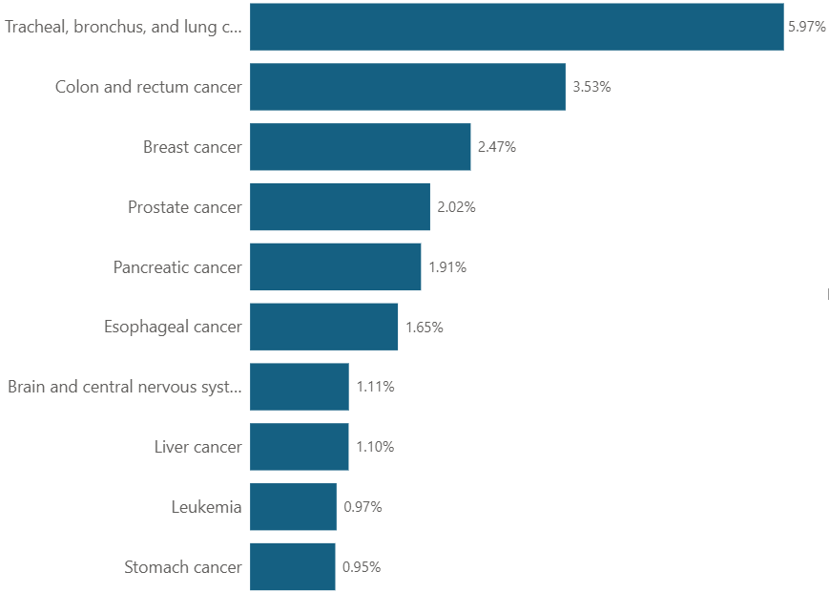
  Preventable premature mortality
Years of Life Lost by Cause in Lincolnshire (2021)
Top 10 Neoplasms in Lincolnshire (2021)
Neoplasms
30%
Cardiovascular diseases
22%
Respiratory Infections & TB
18%
Chronic Respiratory diseases 7%
Neurological Disorders
6%
2%
Digestive Diseases 5%
2%
2%
Other 6%
Sources: Institute for Health Metrics and Evaluation (IHME). GBD Compare Data Visualization. Seattle, WA: IHME, University of Washington, 2023. Available from https://vizhub.healthdata.org/gbd-compare. (Accessed Feb 2026)

Slide 49
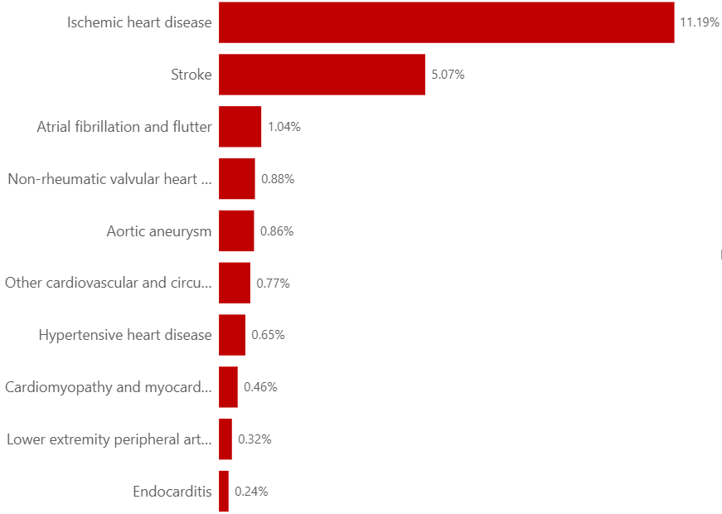
  Preventable premature mortality
Years of Life Lost by Cause in Lincolnshire (2021)
Top 10 Cardiovascular Diseases in Lincolnshire (2021)
Neoplasms
30%
Cardiovascular diseases
22%
Respiratory Infections & TB
18%
Chronic Respiratory diseases 7%
Neurological Disorders
6%
2%
Digestive Diseases 5%
2%
2%
Other 6%
Sources: Institute for Health Metrics and Evaluation (IHME). GBD Compare Data Visualization. Seattle, WA: IHME, University of Washington, 2023. Available from https://vizhub.healthdata.org/gbd-compare. (Accessed Feb 2026)

Slide 50

  Preventable premature mortality
Years of Life Lost by Cause in Lincolnshire (2021)
Respiratory Infections & TB in Lincolnshire (2021)
Neoplasms
30%
Cardiovascular diseases
22%
Respiratory Infections & TB
18%
Chronic Respiratory diseases 7%
Neurological Disorders
6%
2%
Digestive Diseases 5%
2%
2%
Other 6%
Sources: Institute for Health Metrics and Evaluation (IHME). GBD Compare Data Visualization. Seattle, WA: IHME, University of Washington, 2023. Available from https://vizhub.healthdata.org/gbd-compare. (Accessed Feb 2026)

Slide 51

  Preventable premature mortality
Years of Life Lost by Cause in Lincolnshire (2021)
Chronic Respiratory Diseases in Lincolnshire (2021)
Neoplasms
30%
Cardiovascular diseases
22%
Respiratory Infections & TB
18%
Chronic Respiratory diseases 7%
Neurological Disorders
6%
2%
Digestive Diseases 5%
2%
2%
Other 6%
Sources: Institute for Health Metrics and Evaluation (IHME). GBD Compare Data Visualization. Seattle, WA: IHME, University of Washington, 2023. Available from https://vizhub.healthdata.org/gbd-compare. (Accessed Feb 2026)

Slide 52

  Preventable premature mortality
Years of Life Lost by Cause in Lincolnshire (2021)
Neurological Disorders in Lincolnshire (2021)
Neoplasms
30%
Cardiovascular diseases
22%
Respiratory Infections & TB
18%
Chronic Respiratory diseases 7%
Neurological Disorders
6%
2%
Digestive Diseases 5%
2%
2%
Other 6%
Sources: Institute for Health Metrics and Evaluation (IHME). GBD Compare Data Visualization. Seattle, WA: IHME, University of Washington, 2023. Available from https://vizhub.healthdata.org/gbd-compare. (Accessed Feb 2026)

Slide 53

  Preventable premature mortality
Years of Life Lost by Cause in Lincolnshire (2021)
Top 10 Digestive Diseases in Lincolnshire (2021)
Neoplasms
30%
Cardiovascular diseases
22%
Respiratory Infections & TB
18%
Chronic Respiratory diseases 7%
Neurological Disorders
6%
2%
Digestive Diseases 5%
2%
2%
Other 6%
Sources: Institute for Health Metrics and Evaluation (IHME). GBD Compare Data Visualization. Seattle, WA: IHME, University of Washington, 2023. Available from https://vizhub.healthdata.org/gbd-compare. (Accessed Feb 2026)

Slide 54

  Preventable premature mortality
Years of Life Lost by Cause in Lincolnshire (2021)
Diabetes & Kidney disease in Lincolnshire (2021)
Neoplasms
30%
Cardiovascular diseases
22%
Respiratory Infections & TB
18%
Chronic Respiratory diseases 7%
Neurological Disorders
6%
Diabetes & Kidney disease
2%
Digestive Diseases 5%
2%
2%
Other 6%
Sources: Institute for Health Metrics and Evaluation (IHME). GBD Compare Data Visualization. Seattle, WA: IHME, University of Washington, 2023. Available from https://vizhub.healthdata.org/gbd-compare. (Accessed Feb 2026)

Slide 55

  Preventable premature mortality
Years of Life Lost by Cause in Lincolnshire (2021)
Self harm and interpersonal violence in Lincolnshire (2021)
Neoplasms
30%
Cardiovascular diseases
22%
Respiratory Infections & TB
18%
Chronic Respiratory diseases 7%
Neurological Disorders
6%
2%
Digestive Diseases 5%
2%
2%
Other 6%
Self harm + interpersonal violence
Sources: Institute for Health Metrics and Evaluation (IHME). GBD Compare Data Visualization. Seattle, WA: IHME, University of Washington, 2023. Available from https://vizhub.healthdata.org/gbd-compare. (Accessed Feb 2026)

Slide 56

  Preventable premature mortality
Years of Life Lost by Cause in Lincolnshire (2021)
Top 10 Unintentional Injuries in Lincolnshire (2021)
Neoplasms
30%
Cardiovascular diseases
22%
Respiratory Infections & TB
18%
Chronic Respiratory diseases 7%
Neurological Disorders
6%
2%
Digestive Diseases 5%
2%
2%
Other 6%
Unintentional injury
Sources: Institute for Health Metrics and Evaluation (IHME). GBD Compare Data Visualization. Seattle, WA: IHME, University of Washington, 2023. Available from https://vizhub.healthdata.org/gbd-compare. (Accessed Feb 2026)

Slide 57

  Preventable premature mortality
Years of Life Lost by Cause in Lincolnshire (2021)
Top 10 Other Causes in Lincolnshire (2021)
Neoplasms
30%
Cardiovascular diseases
22%
Respiratory Infections & TB
18%
Chronic Respiratory diseases 7%
Neurological Disorders
6%
2%
Digestive Diseases 5%
2%
2%
Other 6%
Sources: Institute for Health Metrics and Evaluation (IHME). GBD Compare Data Visualization. Seattle, WA: IHME, University of Washington, 2023. Available from https://vizhub.healthdata.org/gbd-compare. (Accessed Feb 2026)

Slide 58
  Preventable premature mortality
Years of Life Lost by Cause in East Midlands (2023)
In 2023, nearly 40% of the years of life lost in the East Midlands were due to Neoplasms or Cardiovascular Diseases.
Other substantial causes contributing to lost years of life were Chronic Respiratory Diseases, Neurological Disorders and Digestive Diseases.
Neoplasms
34%
Cardiovascular Diseases
25%
Chronic Respiratory Diseases 7%
Digestive Diseases
7%
Neurological Disorders
7%
Diabetes & Kidney Disease 3%
Unintentional Injury 3%
Respiratory Infections 4%
2%
2%
1%
Other 6%
Self harm + interpersonal violence
Substance use disorders
Maternal & neonatal
Sources: Institute for Health Metrics and Evaluation (IHME). GBD Compare Data Visualization. Seattle, WA: IHME, University of Washington, 2025. Available from https://vizhub.healthdata.org/gbd-compare. (Accessed Feb 2026)

Slide 59

  Preventable premature mortality
Years of Life Lost by Cause in East Midlands (2023)
Top 10 Sub-Causes of Years of Life Lost in East Midlands (2023)
Neoplasms
34%
Cardiovascular Diseases
25%
Chronic Respiratory Diseases 7%
Digestive Diseases
7%
Neurological Disorders
7%
Diabetes & Kidney Disease 3%
Unintentional Injury 3%
Respiratory Infections 4%
2%
2%
1%
Other 6%
Self harm + interpersonal violence
Substance use disorders
Maternal & neonatal
Sources: Institute for Health Metrics and Evaluation (IHME). GBD Compare Data Visualization. Seattle, WA: IHME, University of Washington, 2025. Available from https://vizhub.healthdata.org/gbd-compare. (Accessed Feb 2026)

Slide 60

  Preventable premature mortality
Years of Life Lost by Cause in East Midlands (2023)
Top 20 Sub-Causes of Years of Life Lost in East Midlands (2023)
Neoplasms
34%
Cardiovascular Diseases
25%
Chronic Respiratory Diseases 7%
Digestive Diseases
7%
Neurological Disorders
7%
Diabetes & Kidney Disease 3%
Unintentional Injury 3%
Respiratory Infections 4%
2%
2%
1%
Other 6%
Self harm + interpersonal violence
Substance use disorders
Maternal & neonatal
Sources: Institute for Health Metrics and Evaluation (IHME). GBD Compare Data Visualization. Seattle, WA: IHME, University of Washington, 2025. Available from https://vizhub.healthdata.org/gbd-compare. (Accessed Feb 2026)

Slide 61

  Preventable premature mortality
Years of Life Lost by Cause in East Midlands (2023)
Top 10 Neoplasms in East Midlands (2023)
Neoplasms
34%
Cardiovascular Diseases
25%
Chronic Respiratory Diseases 7%
Digestive Diseases
7%
Neurological Disorders
7%
Diabetes & Kidney Disease 3%
Unintentional Injury 3%
Respiratory Infections 4%
2%
2%
1%
Other 6%
Sources: Institute for Health Metrics and Evaluation (IHME). GBD Compare Data Visualization. Seattle, WA: IHME, University of Washington, 2025. Available from https://vizhub.healthdata.org/gbd-compare. (Accessed Feb 2026)

Slide 62

  Preventable premature mortality
Years of Life Lost by Cause in East Midlands (2023)
Top 10 Cardiovascular Diseases in East Midlands (2023)
Neoplasms
34%
Cardiovascular Diseases
25%
Chronic Respiratory Diseases 7%
Digestive Diseases
7%
Neurological Disorders
7%
Diabetes & Kidney Disease 3%
Unintentional Injury 3%
Respiratory Infections 4%
2%
2%
1%
Other 6%
Sources: Institute for Health Metrics and Evaluation (IHME). GBD Compare Data Visualization. Seattle, WA: IHME, University of Washington, 2025. Available from https://vizhub.healthdata.org/gbd-compare. (Accessed Feb 2026)

Slide 63

  Preventable premature mortality
Years of Life Lost by Cause in East Midlands (2023)
Chronic Respiratory Diseases in East Midlands (2023)
Neoplasms
34%
Cardiovascular Diseases
25%
Chronic Respiratory Diseases 7%
Digestive Diseases
7%
Neurological Disorders
7%
Diabetes & Kidney Disease 3%
Unintentional Injury 3%
Respiratory Infections 4%
2%
2%
1%
Other 6%
Sources: Institute for Health Metrics and Evaluation (IHME). GBD Compare Data Visualization. Seattle, WA: IHME, University of Washington, 2025. Available from https://vizhub.healthdata.org/gbd-compare. (Accessed Feb 2026)

Slide 64

  Preventable premature mortality
Years of Life Lost by Cause in East Midlands (2023)
Top 10 Digestive Diseases in East Midlands (2023)
Neoplasms
34%
Cardiovascular Diseases
25%
Chronic Respiratory Diseases 7%
Digestive Diseases
7%
Neurological Disorders
7%
Diabetes & Kidney Disease 3%
Unintentional Injury 3%
Respiratory Infections 4%
2%
2%
1%
Other 6%
Sources: Institute for Health Metrics and Evaluation (IHME). GBD Compare Data Visualization. Seattle, WA: IHME, University of Washington, 2025. Available from https://vizhub.healthdata.org/gbd-compare. (Accessed Feb 2026)

Slide 65

  Preventable premature mortality
Years of Life Lost by Cause in East Midlands (2023)
Neurological Disorders in East Midlands (2023)
Neoplasms
34%
Cardiovascular Diseases
25%
Chronic Respiratory Diseases 7%
Digestive Diseases
7%
Neurological Disorders
7%
Diabetes & Kidney Disease 3%
Unintentional Injury 3%
Respiratory Infections 4%
2%
2%
1%
Other 6%
Sources: Institute for Health Metrics and Evaluation (IHME). GBD Compare Data Visualization. Seattle, WA: IHME, University of Washington, 2025. Available from https://vizhub.healthdata.org/gbd-compare. (Accessed Feb 2026)

Slide 66

  Preventable premature mortality
Years of Life Lost by Cause in East Midlands (2023)
Respiratory Infections in East Midlands (2023)
Neoplasms
34%
Cardiovascular Diseases
25%
Chronic Respiratory Diseases 7%
Digestive Diseases
7%
Neurological Disorders
7%
Diabetes & Kidney Disease 3%
Unintentional Injury 3%
Respiratory Infections 4%
2%
2%
1%
Other 6%
Sources: Institute for Health Metrics and Evaluation (IHME). GBD Compare Data Visualization. Seattle, WA: IHME, University of Washington, 2025. Available from https://vizhub.healthdata.org/gbd-compare. (Accessed Feb 2026)

Slide 67

  Preventable premature mortality
Years of Life Lost by Cause in East Midlands (2023)
Diabetes & Kidney Diseases in East Midlands (2023)
Neoplasms
34%
Cardiovascular Diseases
25%
Chronic Respiratory Diseases 7%
Digestive Diseases
7%
Neurological Disorders
7%
Diabetes & Kidney Disease 3%
Unintentional Injury 3%
Respiratory Infections 4%
2%
2%
1%
Other 6%
Sources: Institute for Health Metrics and Evaluation (IHME). GBD Compare Data Visualization. Seattle, WA: IHME, University of Washington, 2025. Available from https://vizhub.healthdata.org/gbd-compare. (Accessed Feb 2026)

Slide 68

  Preventable premature mortality
Years of Life Lost by Cause in East Midlands (2023)
Top 10 Unintentional Injuries in East Midlands (2023)
Neoplasms
34%
Cardiovascular Diseases
25%
Chronic Respiratory Diseases 7%
Digestive Diseases
7%
Neurological Disorders
7%
Diabetes & Kidney Disease 3%
Unintentional Injury 3%
Respiratory Infections 4%
2%
2%
1%
Other 6%
Sources: Institute for Health Metrics and Evaluation (IHME). GBD Compare Data Visualization. Seattle, WA: IHME, University of Washington, 2025. Available from https://vizhub.healthdata.org/gbd-compare. (Accessed Feb 2026)

Slide 69

  Preventable premature mortality
Years of Life Lost by Cause in East Midlands (2023)
Self harm and interpersonal violence in East Midlands (2023)
Neoplasms
34%
Cardiovascular Diseases
25%
Chronic Respiratory Diseases 7%
Digestive Diseases
7%
Neurological Disorders
7%
Diabetes & Kidney Disease 3%
Unintentional Injury 3%
Respiratory Infections 4%
2%
2%
1%
Other 6%
Self harm + interpersonal violence
Sources: Institute for Health Metrics and Evaluation (IHME). GBD Compare Data Visualization. Seattle, WA: IHME, University of Washington, 2025. Available from https://vizhub.healthdata.org/gbd-compare. (Accessed Feb 2026)

Slide 70

  Preventable premature mortality
Years of Life Lost by Cause in East Midlands (2023)
Substance use disorders in East Midlands (2023)
Neoplasms
34%
Cardiovascular Diseases
25%
Chronic Respiratory Diseases 7%
Digestive Diseases
7%
Neurological Disorders
7%
Diabetes & Kidney Disease 3%
Unintentional Injury 3%
Respiratory Infections 4%
2%
2%
1%
Other 6%
Substance use disorders
Sources: Institute for Health Metrics and Evaluation (IHME). GBD Compare Data Visualization. Seattle, WA: IHME, University of Washington, 2025. Available from https://vizhub.healthdata.org/gbd-compare. (Accessed Feb 2026)

Slide 71

  Preventable premature mortality
Years of Life Lost by Cause in East Midlands (2023)
Maternal & Neonatal disorders in East Midlands (2023)
Neoplasms
34%
Cardiovascular Diseases
25%
Chronic Respiratory Diseases 7%
Digestive Diseases
7%
Neurological Disorders
7%
Diabetes & Kidney Disease 3%
Unintentional Injury 3%
Respiratory Infections 4%
2%
2%
1%
Other 6%
Maternal & neonatal
Sources: Institute for Health Metrics and Evaluation (IHME). GBD Compare Data Visualization. Seattle, WA: IHME, University of Washington, 2025. Available from https://vizhub.healthdata.org/gbd-compare. (Accessed Feb 2026)

Slide 72

  Preventable premature mortality
Years of Life Lost by Cause in East Midlands (2023)
Top 10 Other Causes in East Midlands (2023)
Neoplasms
34%
Cardiovascular Diseases
25%
Chronic Respiratory Diseases 7%
Digestive Diseases
7%
Neurological Disorders
7%
Diabetes & Kidney Disease 3%
Unintentional Injury 3%
Respiratory Infections 4%
2%
2%
1%
Other 6%
Sources: Institute for Health Metrics and Evaluation (IHME). GBD Compare Data Visualization. Seattle, WA: IHME, University of Washington, 2025. Available from https://vizhub.healthdata.org/gbd-compare. (Accessed Feb 2026)

Slide 73


  Years lived with disability
Musculoskeletal, mental and neurological disorders are the leading causes of disability in Lincolnshire and the East Midlands.
Top 10 causes of years lived with disability, East Midlands, 2023
Top 10 causes of years lived with disability, Lincolnshire , 2021
Sources: (1) Lincolnshire Data Management Environment (not externally accessible). November 2022 to October 2025. (2) Institute for Health Metrics and Evaluation (IHME). GBD Compare Data Visualization. Seattle, WA: IHME, University of Washington, 2025. Available from https://vizhub.healthdata.org/gbd-compare. (Accessed Feb 2026)

Slide 74

  Preventable premature mortality and morbidity
Smoking, alcohol use and diet-related risk factors are associated with the highest proportion of DALYs in the East Midlands region.
Percent of total DALYs associated with risk factors, East Midlands, 2023
Cardiovascular diseases
Neoplasms
Respiratory diseases
Diabetes & kidney diseases
Digestive diseases
External causes
Mental & behavioural diseases
Substance use disorders
Other
Source: Institute for Health Metrics and Evaluation (IHME). GBD Compare Data Visualization. Seattle, WA: IHME, University of Washington, 2025. Available from https://vizhub.healthdata.org/gbd-compare. (Accessed Feb 2026])

Slide 75
Health Inequalities

Slide 76

  Mortality by Deprivation
Across major disease categories, people living in more deprived areas of Lincolnshire suffer significantly higher mortality than those living in less deprived areas
Directly age-sex standardised mortality rate per 100,000 people per year, by underlying cause of death, by deprivation decile (2023 – 2025)
Source: Lincolnshire Data Management Environment (not externally accessible). January 2023 to December 2025.
Note: Disease categories based on ICD10 Chapters as outlined in ICD-10-5TH-Edition Volume 1 – Tabular list, U509 categorised as External cause of mortality in line with Mortality statistics by location - Office for National Statistics. Direct age-sex standardisation carried out using the EU Standard Population 2013.

Slide 77

  Mortality by Deprivation – Circulatory System
The mortality rate due to diseases of the circulatory system is 144% higher in the most deprived decile compared to the least deprived decile.
Directly age-sex standardised mortality rate per 100,000 people per year, by deprivation decile (2023 – 2025)
223 deaths per 100,000 people per year difference*
Most deprived
Least deprived
Source: Lincolnshire Data Management Environment (not externally accessible). January 2023 to December 2025.
Note: Disease categories based on ICD10 Chapters as outlined in ICD-10-5TH-Edition Volume 1 – Tabular list, U509 categorised as External cause of mortality in line with Mortality statistics by location - Office for National Statistics. *Based on direct age-sex standardisation carried out using the EU Standard Population 2013.

Slide 78

  Mortality by Deprivation – Neoplasms
The mortality rate due to Neoplasms is 109% higher in the most deprived decile compared to the least deprived decile.
Directly age-sex standardised mortality rate per 100,000 people per year, by deprivation decile (2023 – 2025)
189 deaths per 100,000 people per year difference*
Most deprived
Least deprived
Source: Lincolnshire Data Management Environment (not externally accessible). January 2023 to December 2025.
Note: Disease categories based on ICD10 Chapters as outlined in ICD-10-5TH-Edition Volume 1 – Tabular list, U509 categorised as External cause of mortality in line with Mortality statistics by location - Office for National Statistics. *Based on direct age-sex standardisation carried out using the EU Standard Population 2013.

Slide 79

  Mortality by Deprivation – Respiratory System
The mortality rate due to diseases of the respiratory system is 237% higher in the most deprived decile compared to the least deprived decile.
Directly age-sex standardised mortality rate per 100,000 people per year, by deprivation decile (2023 – 2025)
132 deaths per 100,000 people per year difference*
Most deprived
Least deprived
Source: Lincolnshire Data Management Environment (not externally accessible). January 2023 to December 2025.
Note: Disease categories based on ICD10 Chapters as outlined in ICD-10-5TH-Edition Volume 1 – Tabular list, U509 categorised as External cause of mortality in line with Mortality statistics by location - Office for National Statistics. *Based on direct age-sex standardisation carried out using the EU Standard Population 2013.

Slide 80

  Mortality by Deprivation – Mental & Behavioural
The mortality rate due to mental & behavioural disorders is 181% higher in the most deprived decile compared to the least deprived decile.
Directly age-sex standardised mortality rate per 100,000 people per year, by deprivation decile (2023 – 2025)
71 deaths per 100,000 people per year difference*
Most deprived
Least deprived
Source: Lincolnshire Data Management Environment (not externally accessible). January 2023 to December 2025.
Note: Disease categories based on ICD10 Chapters as outlined in ICD-10-5TH-Edition Volume 1 – Tabular list, U509 categorised as External cause of mortality in line with Mortality statistics by location - Office for National Statistics. *Based on direct age-sex standardisation carried out using the EU Standard Population 2013.

Slide 81

  Mortality by Deprivation – Nervous System
The mortality rate due to nervous system diseases is 217% higher in the most deprived decile compared to the least deprived decile
Directly age-sex standardised mortality rate per 100,000 people per year, by deprivation decile (2023 – 2025)
67 deaths per 100,000 people per year difference*
Most deprived
Least deprived
Source: Lincolnshire Data Management Environment (not externally accessible). January 2023 to December 2025.
Note: Disease categories based on ICD10 Chapters as outlined in ICD-10-5TH-Edition Volume 1 – Tabular list, U509 categorised as External cause of mortality in line with Mortality statistics by location - Office for National Statistics. *Based on direct age-sex standardisation carried out using the EU Standard Population 2013.

Slide 82

  Mortality by Deprivation – Digestive System
The mortality rate due diseases of the digestive system is 172% higher in the most deprived decile compared to the least deprived decile
Directly age-sex standardised mortality rate per 100,000 people per year, by deprivation decile (2023 – 2025)
57 deaths per 100,000 people per year difference*
Most deprived
Least deprived
Source: Lincolnshire Data Management Environment (not externally accessible). January 2023 to December 2025.
Note: Disease categories based on ICD10 Chapters as outlined in ICD-10-5TH-Edition Volume 1 – Tabular list, U509 categorised as External cause of mortality in line with Mortality statistics by location - Office for National Statistics. *Based on direct age-sex standardisation carried out using the EU Standard Population 2013.

Slide 83

  Mortality by Deprivation – External causes
The mortality rate due external causes is 179% higher in the most deprived decile compared to the least deprived decile
Directly age-sex standardised mortality rate per 100,000 people per year, by deprivation decile (2023 – 2025)
43 deaths per 100,000 people per year difference*
Most deprived
Least deprived
Source: Lincolnshire Data Management Environment (not externally accessible). January 2023 to December 2025.
Note: Disease categories based on ICD10 Chapters as outlined in ICD-10-5TH-Edition Volume 1 – Tabular list, U509 categorised as External cause of mortality in line with Mortality statistics by location - Office for National Statistics. *Based on direct age-sex standardisation carried out using the EU Standard Population 2013.

Slide 84

  Mortality by Deprivation – Endocrine, nutritional and metabolic
The mortality rate due endocrine, nutritional and metabolic causes is 241% higher in the most deprived decile compared to the least deprived decile
Directly age-sex standardised mortality rate per 100,000 people per year, by deprivation decile (2023 – 2025)
25 deaths per 100,000 people per year difference*
Most deprived
Least deprived
Source: Lincolnshire Data Management Environment (not externally accessible). January 2023 to December 2025.
Note: Disease categories based on ICD10 Chapters as outlined in ICD-10-5TH-Edition Volume 1 – Tabular list, U509 categorised as External cause of mortality in line with Mortality statistics by location - Office for National Statistics. *Based on direct age-sex standardisation carried out using the EU Standard Population 2013.

Slide 85

  Mortality by Deprivation – Genitourinary System
The mortality rate due endocrine, nutritional and metabolic causes is 283% higher in the most deprived decile compared to the least deprived decile
Directly age-sex standardised mortality rate per 100,000 people per year, by deprivation decile (2023 – 2025)
20 deaths per 100,000 people per year difference*
Most deprived
Least deprived
Source: Lincolnshire Data Management Environment (not externally accessible). January 2023 to December 2025.
Note: Disease categories based on ICD10 Chapters as outlined in ICD-10-5TH-Edition Volume 1 – Tabular list, U509 categorised as External cause of mortality in line with Mortality statistics by location - Office for National Statistics. *Based on direct age-sex standardisation carried out using the EU Standard Population 2013.

Slide 86

  Hospital Admissions by Deprivation
There are 66.5% more emergency hospital admissions in the most deprived quintile compared to the least deprived – whilst elective hospital admissions are more similar.
Directly age-sex standardised hospital admissions per 100,000 people per year, by deprivation quintile (2023 – 2025)
This implies there is greater healthcare need in more deprived areas, and this is being delt with through emergency admissions, rather than elective admissions
Most deprived
Least deprived
Source: Lincolnshire Data Management Environment (not externally accessible). January 2023 to December 2025.
Note: Based on direct age-sex standardisation carried out using the EU Standard Population 2013.

Slide 87


  Life expectancy
Areas of Lincolnshire with higher levels of deprivation have lower life expectancy. However, the slope index of inequality is less steep in Lincolnshire (8.8) than for England as a whole (10.5).
Life Expectancy at birth (Male), 2019-2023
Life Expectancy at birth (Female), 2019-2023
Average life expectancy across MSOAs: 78.7
Average life expectancy across MSOAs: 82.7
Less deprived
Index of Multiple Deprivation Score (2025)*
More deprived
Less deprived
Index of Multiple Deprivation Score (2025)*
More deprived
Lincolnshire MSOA
Linear Trend Line
Lincolnshire MSOA
Linear Trend Line
Source: Fingertips, OHID, based on Office for National Statistics data and English Indices of Multiple Deprivation 2025.
Note: *Calculated through a population-weighted average of LSOA IMD scores.

Slide 88

  Contributors to life expectancy gap
Life Expectancy gap between most and least deprived quintiles, by cause of death, females
In Lincolnshire’s female population, the life expectancy gap between the most and least deprived areas has varied over recent years. Though, the gap has consistently been driven by:
Circulatory deaths
Cancer deaths
Respiratory deaths
Whilst contributing less towards the life expectancy gap, deaths due to digestive, external, and mental and behavioural causes contributed more towards the gap in 2022-23 than they did in previous years.
Source: Office for Health Improvement and Disparities based on ONS death registration data and mid year population estimates for the relevant years, and Ministry of Housing, Communities and Local Government Index of Multiple Deprivation, 2019

Slide 89

  Contributors to life expectancy gap
Life Expectancy gap between most and least deprived quintiles, by cause of death, males
In Lincolnshire’s male population, the life expectancy gap between the most and least deprived areas has grown. The growth in this gap has been primarily driven by:
Circulatory deaths
Deaths from external causes
Whilst still large contributors to the overall life expectancy gap, cancers and respiratory causes of death now explain a smaller proportion of the gap.
Source: Office for Health Improvement and Disparities based on ONS death registration data and mid year population estimates for the relevant years, and Ministry of Housing, Communities and Local Government Index of Multiple Deprivation, 2019

Slide 90


  Geographic Inequality
The coastal regions of Lincolnshire are the most deprived overall, and there also exists high levels of deprivation within urban areas.
Index of Multiple Deprivation Quintile
Proportion of Population in each Deprivation Quintile
More deprived
1
2
3
4
5
Less deprived
Source: English Indices of Multiple Deprivation 2025

Slide 91


  Geographic Inequality
Much of the income deprivation affecting children is concentrated in urban areas and in the coastal areas.
Income Deprivation Affecting Children Quintile
Proportion of Dependent Children Aged 0-15 years old in each Quintile
More deprived
1
2
3
4
5
Less deprived
Source: English Indices of Multiple Deprivation 2025

Slide 92


  Geographic Inequality
A smaller proportion of Lincolnshire’s older population are affected by income deprivation than in England, with the highest income deprivation affecting older people in urban areas.
Income Deprivation Affecting Older People Quintile
Proportion of Older People aged 60 and over in each Quintile
More deprived
1
2
3
4
5
Less deprived
Source: English Indices of Multiple Deprivation 2025

Slide 93





  Geographic Inequality
Patients in rural and coastal regions need to travel long distances to access health services, particularly hospital care.
Access to any Healthcare in Lincolnshire
Proportion of Lincolnshire’s population able to access a GP within 15 minutes, by mode of transport
Car
Public Transport
Source: Department of Transport, Journey Time Statistics 2019

Slide 94



  Geographic Inequality
Disposable incomes across Lincolnshire vary considerably, with urban populations earning the lowest on average, after housing costs.
Mean net household income after housing costs, by MSOA (FYE 2024)
MSOA count by net household income after housing costs (FYE 2024), by Local Authority District
Lincoln
Source: Households below average income (HBAI) statistics - GOV.UK

Slide 95




  Geographic Inequality
Lincolnshire has a lower proportion of people with level 4 qualifications than across England, and high concentrations of people with no qualifications in coastal areas.
Percent of population over 16 years old with no qualifications, 2021
Percent of population over 16 years old with no qualifications, 2021
Source: ONS Census 2021

Slide 96

  Preventable premature mortality
Lincolnshire has higher preventable mortality than England, and many of its statistical neighbours, but is similar to other regions in the East Midlands.
Under 75 mortality rate from causes considered preventable (1 year range - 2024), Directly standardised rate per 100,000
Source: Fingertips, OHID, based on Office for National Statistics data

Slide 97



  Distribution of risk factors
Smoking is most prevalent in Lincolnshire’s coastal and deprived urban areas, with moderately high levels in deprived rural communities, and the lowest rates in less deprived rural areas.
Percent of registered patients currently smoking, 2025
Lincolnshire LSOAs by deprivation score and smoking prevalence, 2025
Source: Lincolnshire ICS Joined Intelligence Dataset, NHS Lincolnshire ICB (Reporting period: Dec 2024- Nov 2025). English Indices of Multiple Deprivation 2025.

Slide 98



  Distribution of risk factors
The deprivation gradient for obesity is less pronounced than for smoking, due to lower rates of obesity in deprived urban areas, and higher rates of obesity in less deprived rural areas.
Percent of registered patients with obesity,
2025
Lincolnshire LSOAs by deprivation score and obesity prevalence,
2025
Source: Lincolnshire ICS Joined Intelligence Dataset, NHS Lincolnshire ICB (Reporting period: Dec 2024- Nov 2025). English Indices of Multiple Deprivation 2025.

Slide 99


  Distribution of risk factors
In 2024, the three most deprived local authority districts had the highest alcohol-related mortality. None of the districts differed significantly from the rate for England.
Alcohol-related mortality (directly standardised per 100,000) by local authority district, 2024
Alcohol-related mortality (directly standardised per 100,000)
Source: Fingertips, OHID, based on Office for National Statistics data

